Slide 1
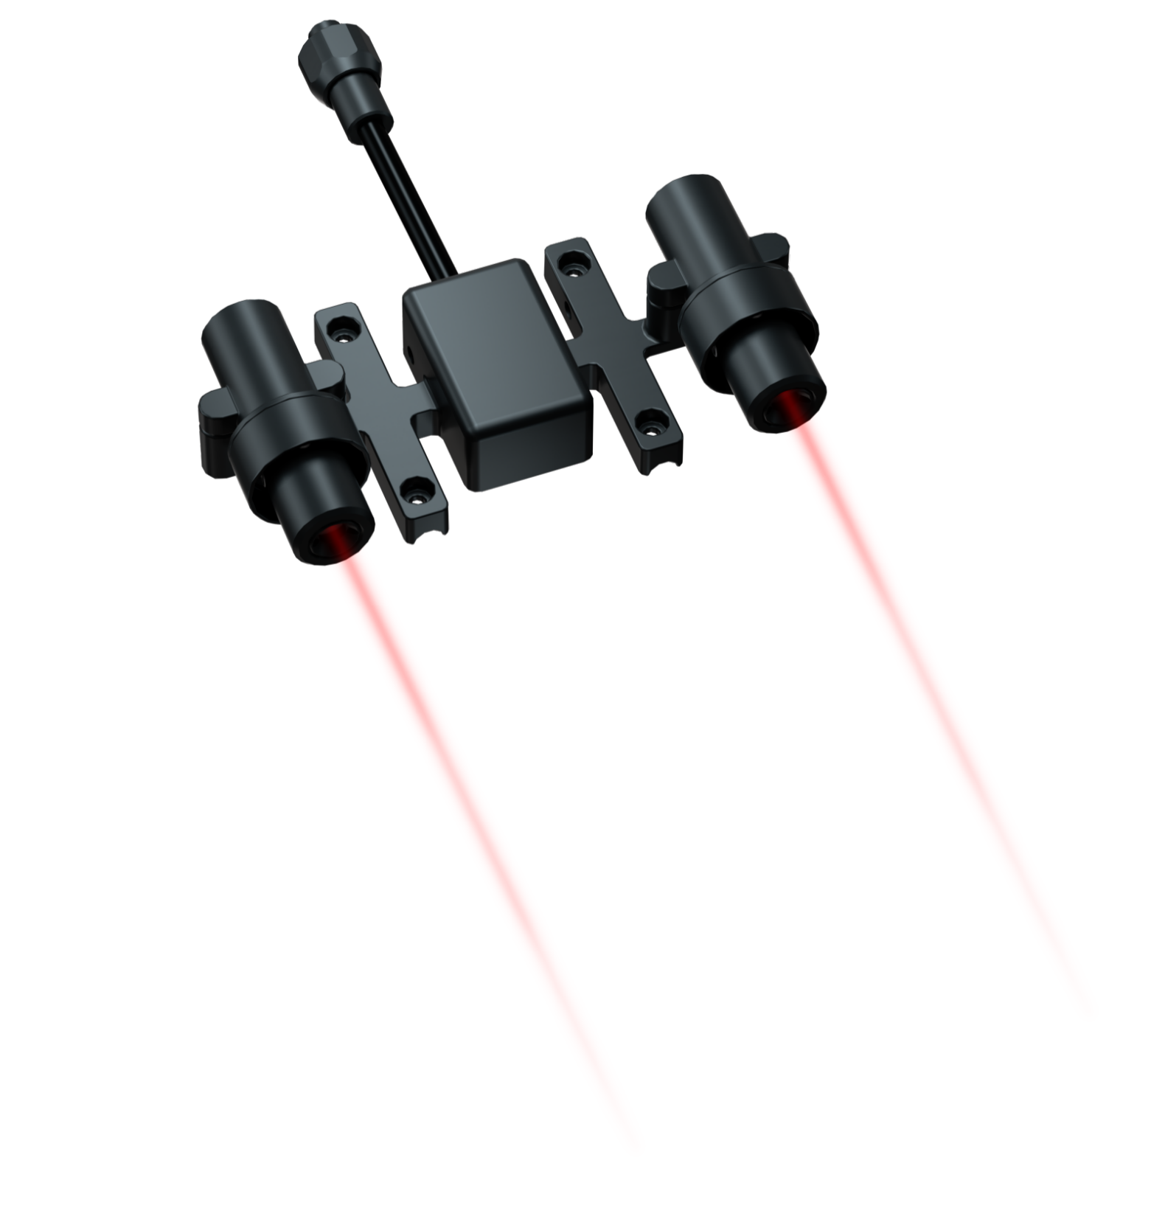
Chasing Laser Scaler
Accessory specially designed for use with
CHASING M2 and CHASING M2 PRO ROV.
www.chasing.com

Slide 2
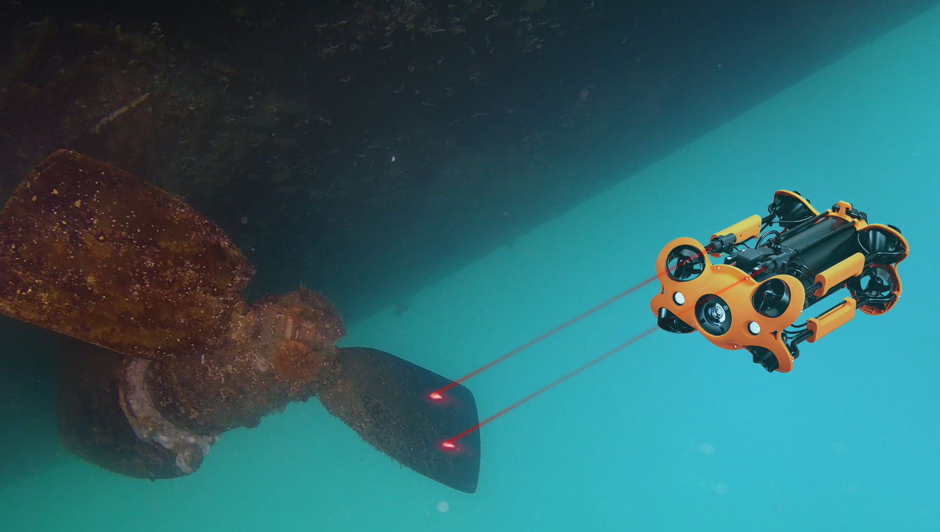
Chasing Laser Scaler is an accessory specially designed for use with CHASING M2 and CHASING M2 PRO ROV. It features a user-friendly 10cm pitch red laser beam and is primarily used for measuring aquaculture products, and calculating the length of cracks in boats, dams, etc. Widely used in aquaculture, dam inspection, and boat repair.

Slide 3
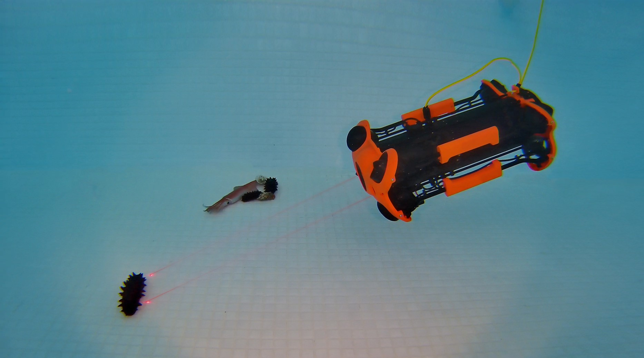
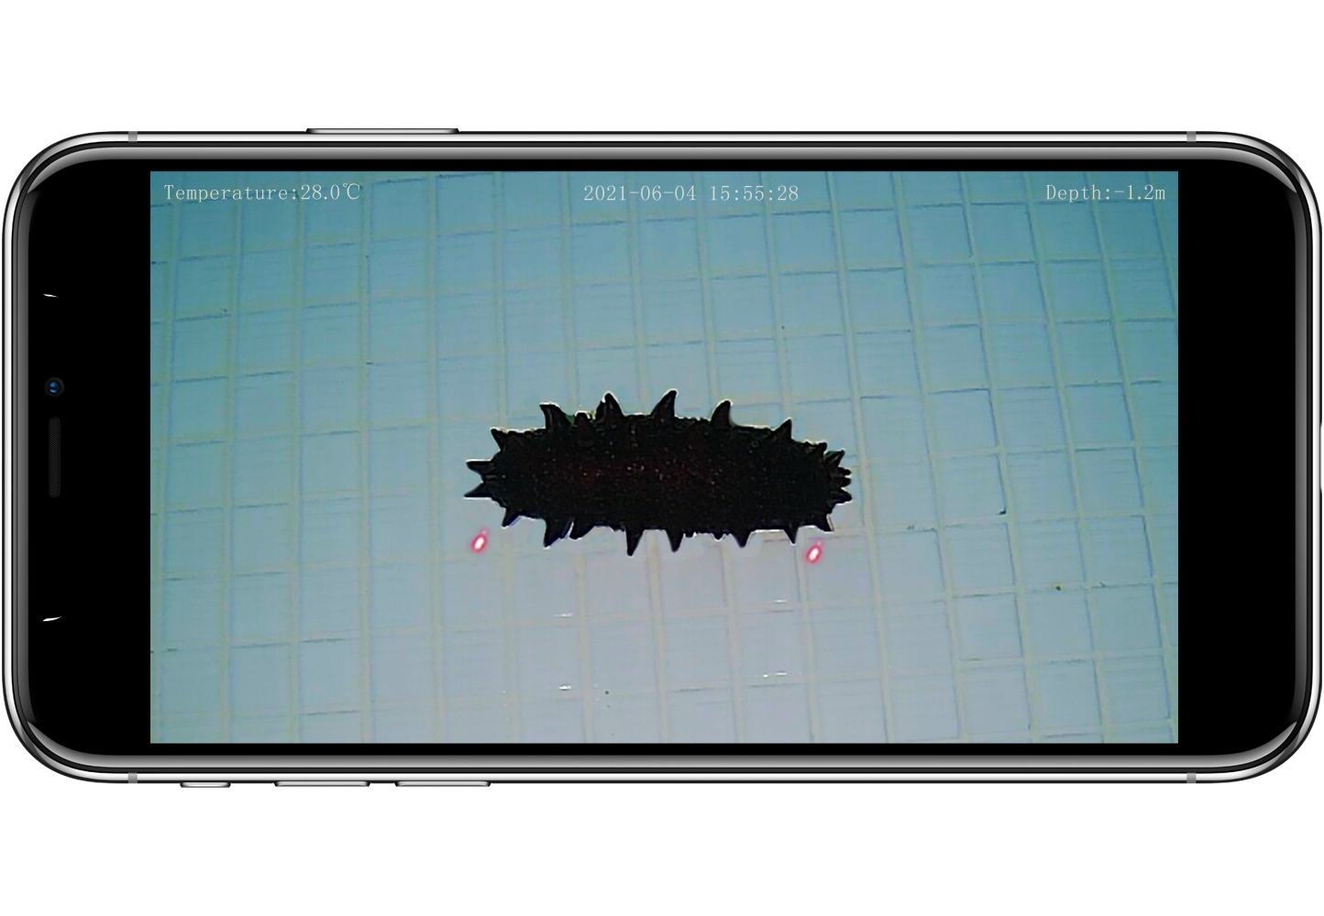

Slide 4
Product Parameter
Chasing Laser Scaler
Size (mm) | 132x70x36.5 mm
Weight | ≈190 g
Operating temperature | -10℃-45℃
Beam exit diameter | 3-5 mm
Laser spacing | 10±0.5 cm
Laser color | Red

Slide 5
Chasing Laser Scaler

