Slide 1
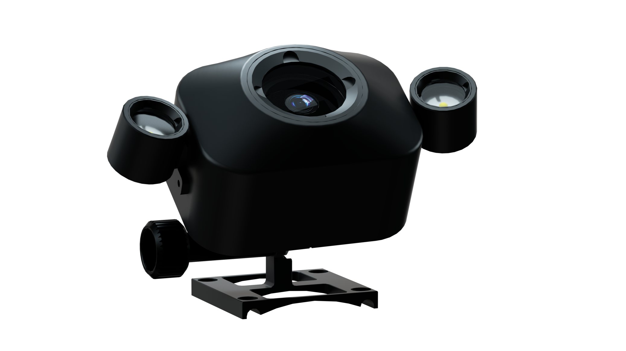
CHASING Auxiliary Camera
Accessory specially designed for use with
CHASING M2 PRO ROV.
www.chasing.com

Slide 2
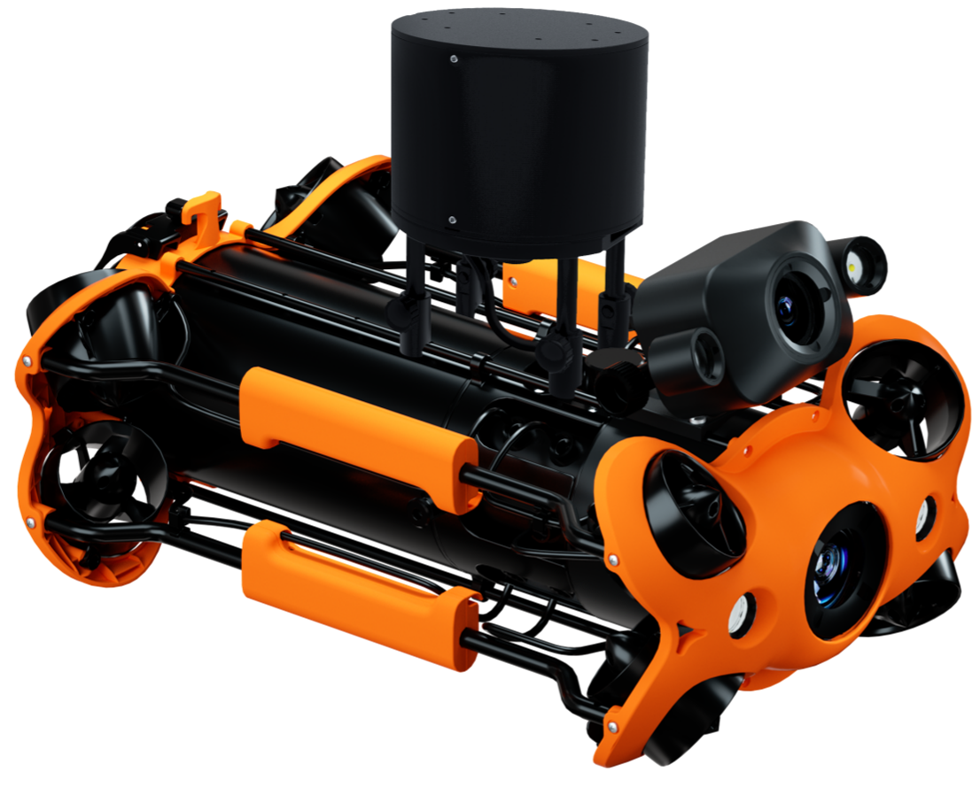
CHASING Auxiliary Camera is specially designed for use with CHASING M2 PRO ROV via the docking station. Used with CHASING GO1 App, it allows users to engage in real-time viewing and shooting via their mobile device, and supports both photography and video functions. It can be used at the same time as the ROV's camera to provide a second angle for the ROV. It features a 1080p F/1.6 aperture and 2*1200 lumens fill light; it uses a 1/2.8 inch CMOS depth sensor and 2 megapixels.

Slide 3
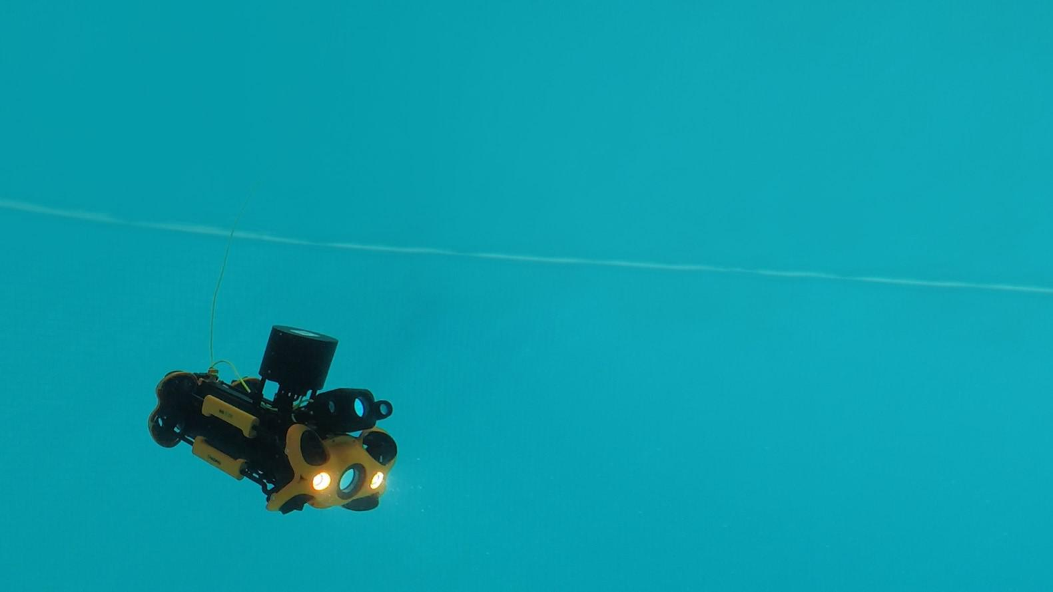
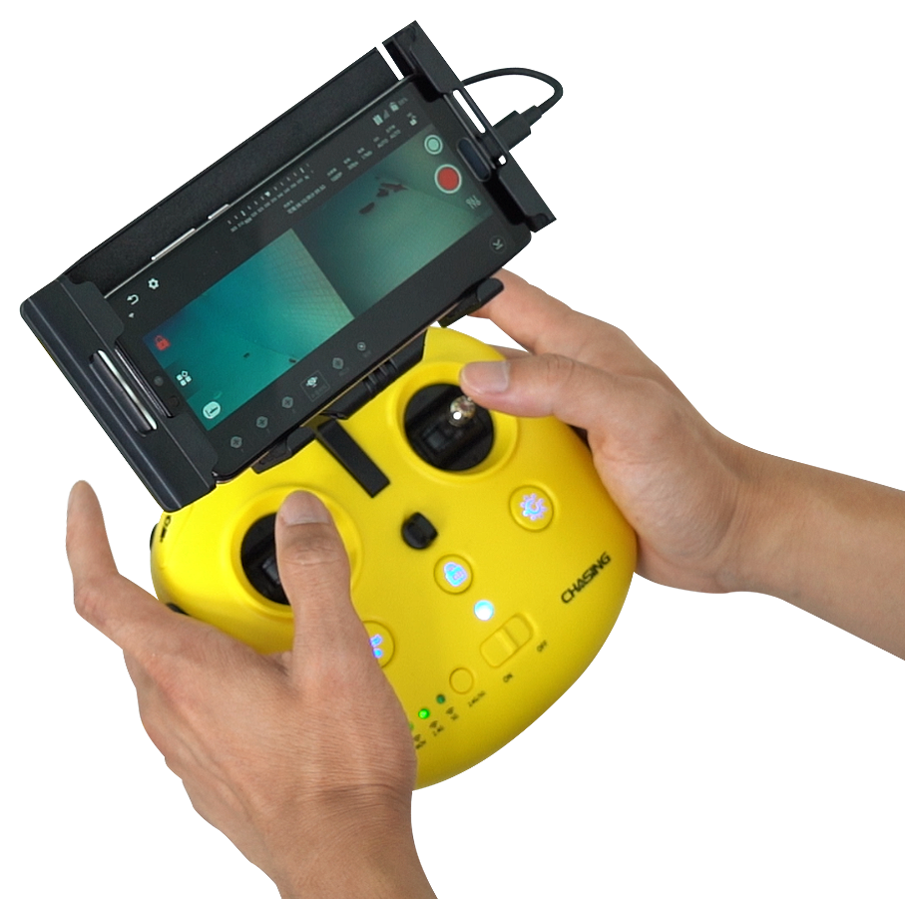
Multi-angle Synchronous Viewing
CHASING Auxiliary Camera
CHASING Auxiliary Camera fits onto ACHASING M2 PRO ROV, allowing it to be simultaneously used with the ROV camera via the docking station, providing a second angle for the ROV.
The App enables users to view and capture video and images in real time.
CHASING M2 PRO

Slide 4
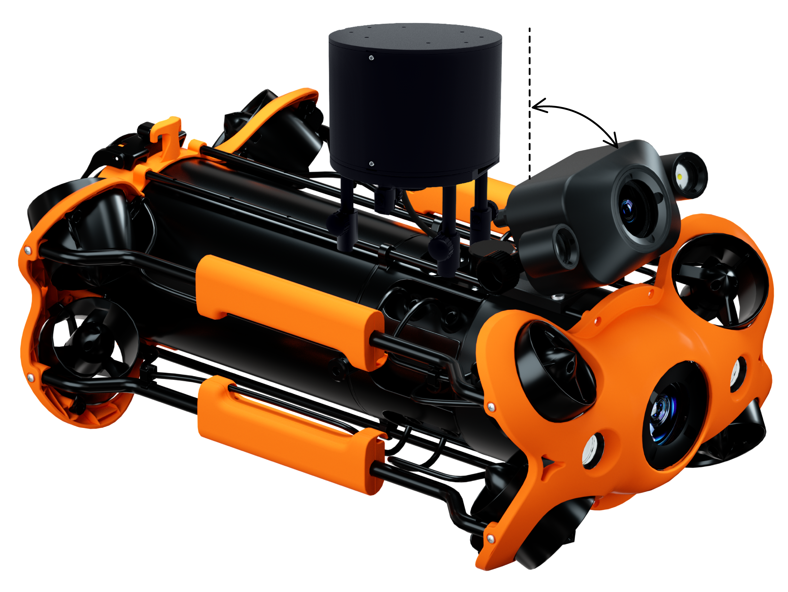
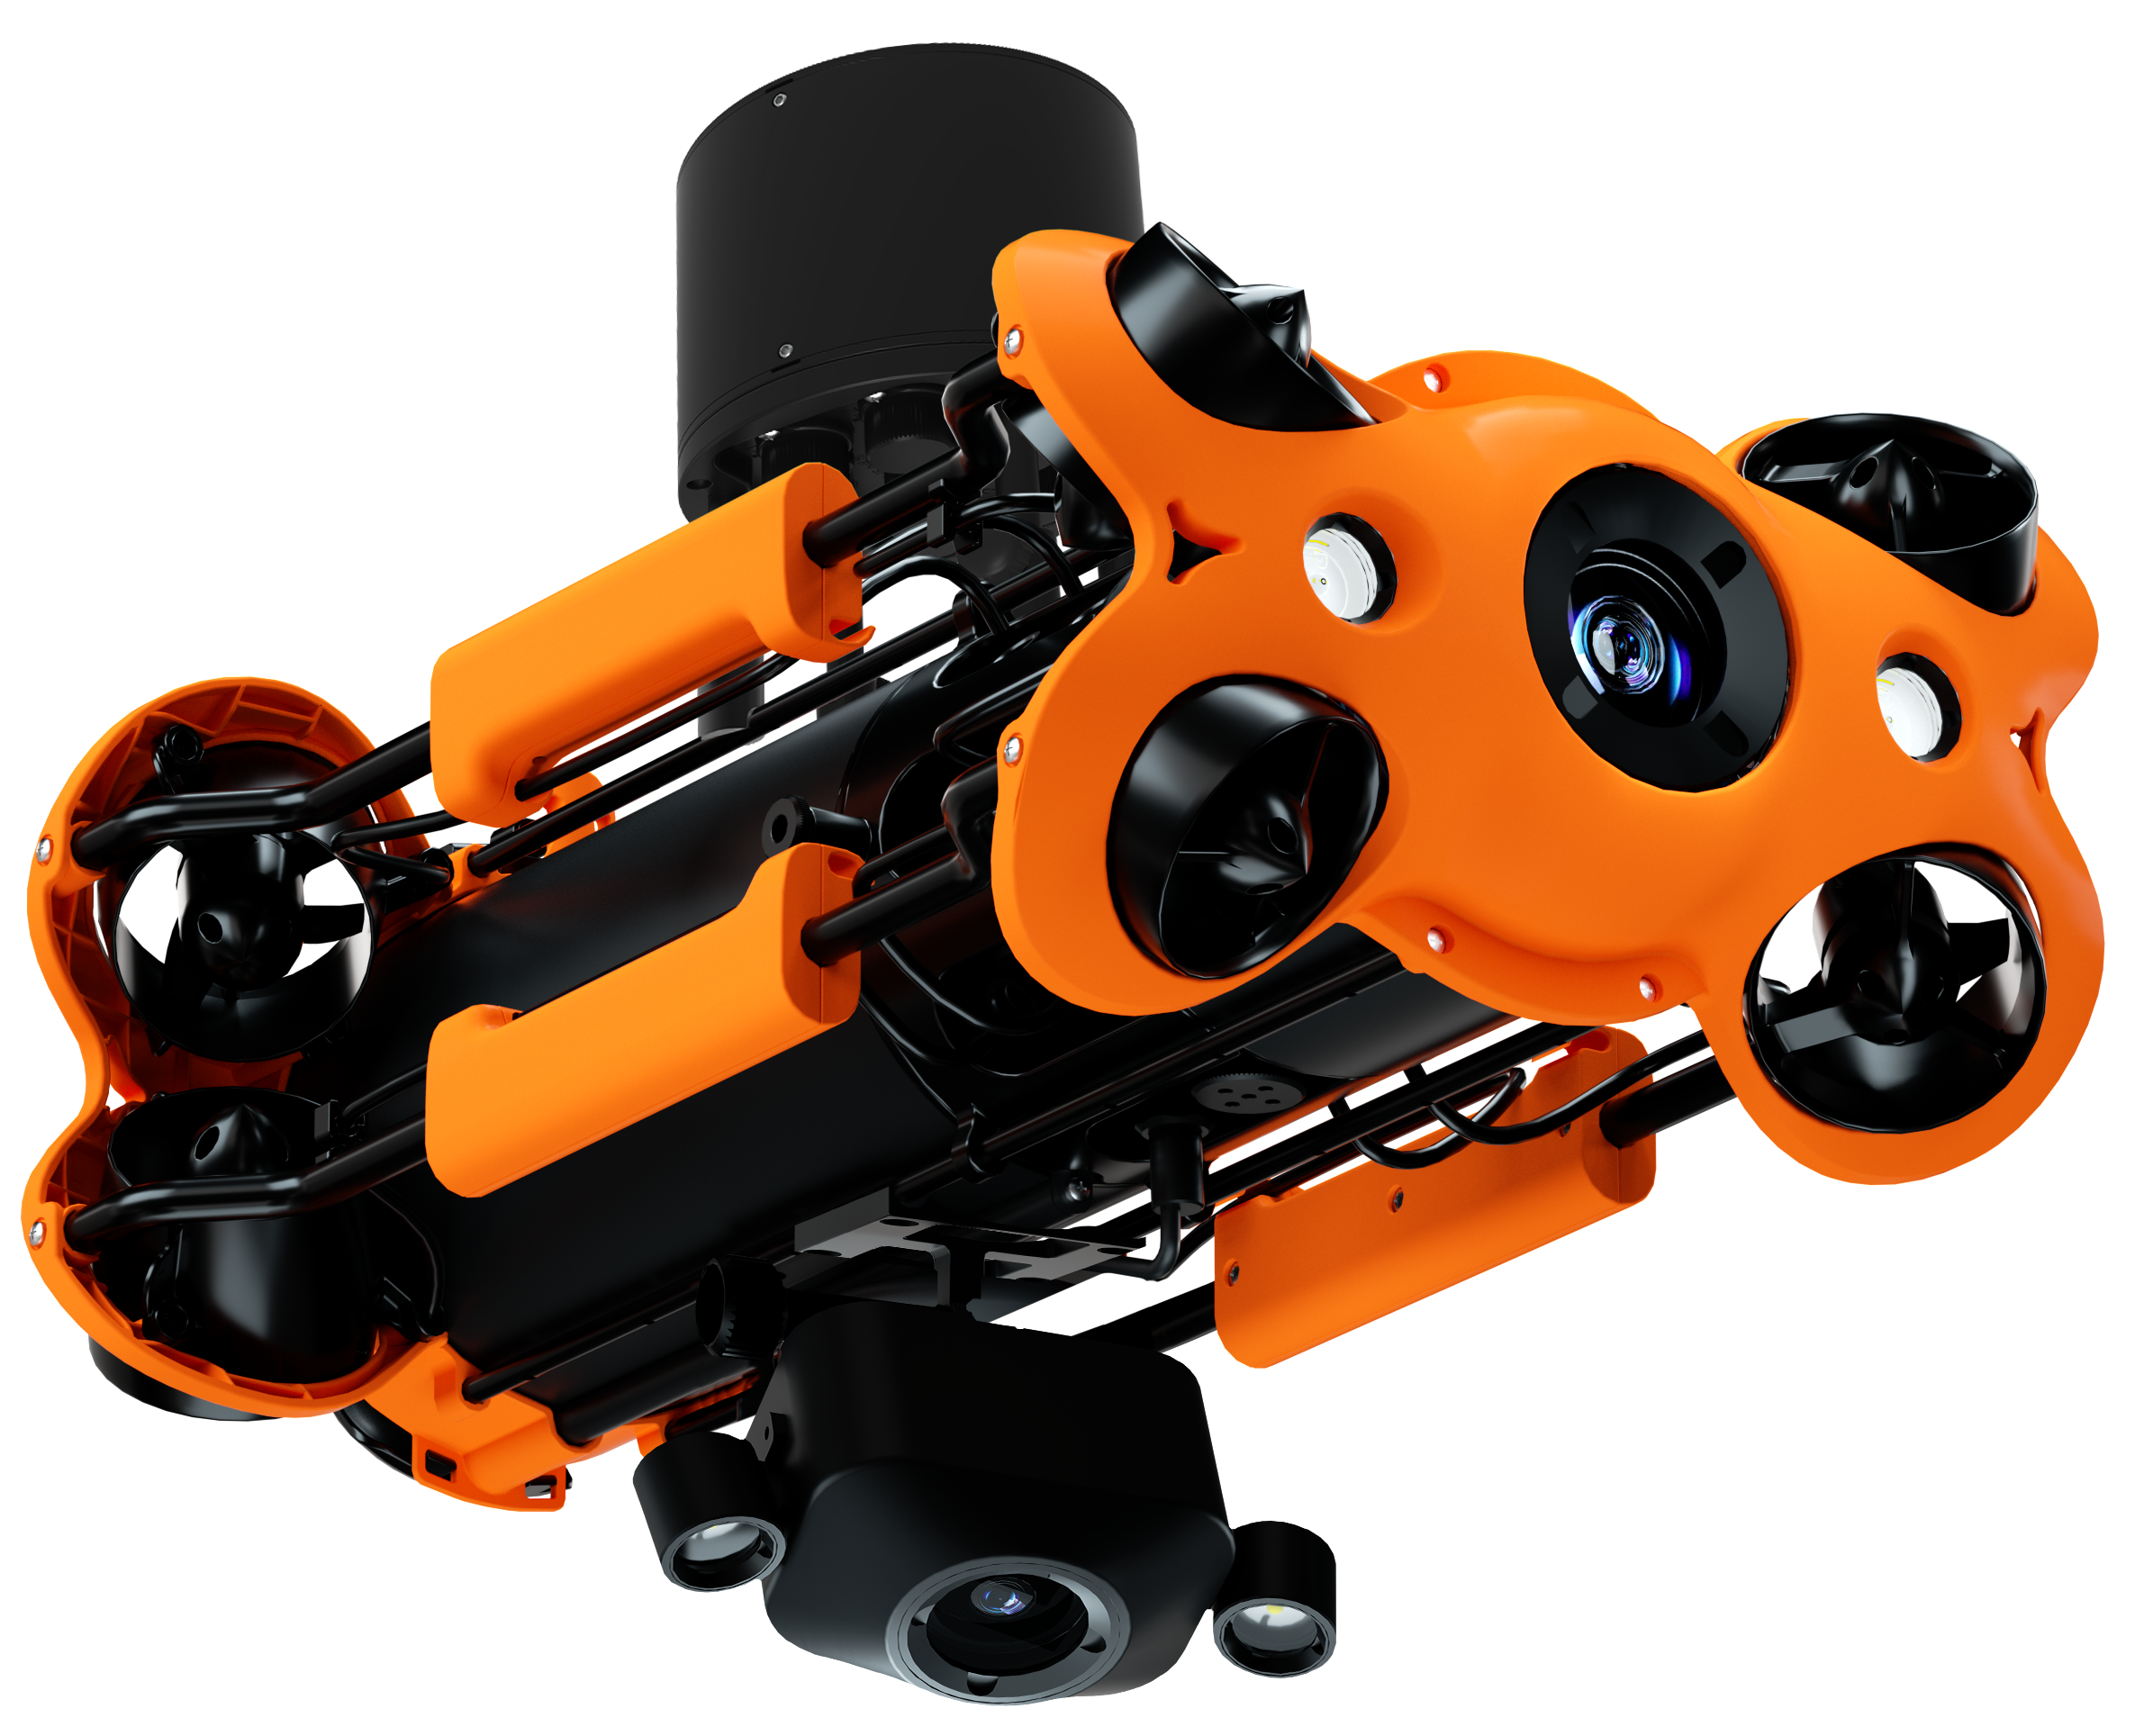
Combine Angles in a Variety of Ways
CHASING Auxiliary Camera can be adjusted within an angle of 0-90 degrees, and can be freely fitted onto the top or bottom of the ROV, allowing the shooting angle to be adjusted in a variety of ways.
0°~90°

Slide 5
Product Parameter
CHASING Auxiliary Camera
Size | 173*71*108 mm
Weight | 536g
Resolution | 2mp
Fill light | 1200lm*2
Sensor | 1/2.9inch
Image formats | JPG, MP4

Slide 6
CHASING Auxiliary Camera

