Slide 1
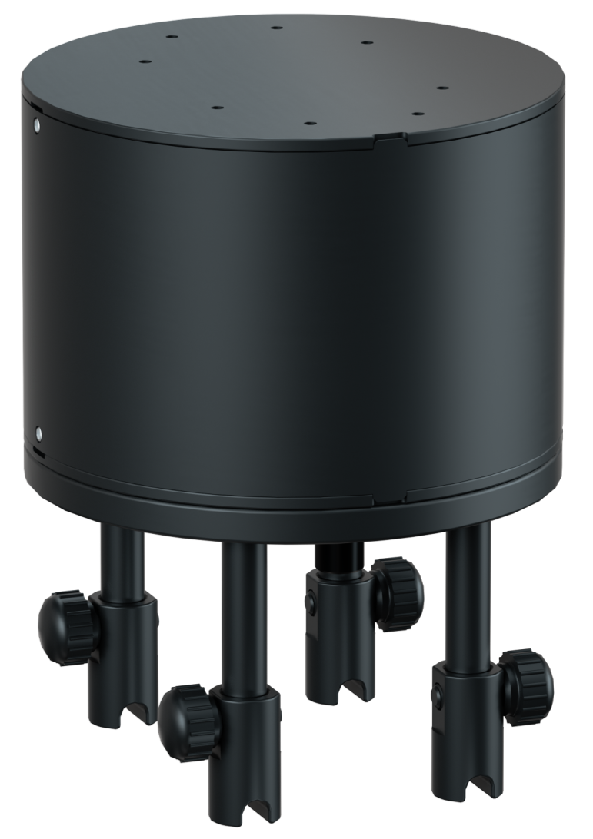
CHASING Multi-interface Docking Station
Accessory specially designed for use with
CHASING M2 PRO ROV.
www.chasing.com

Slide 2
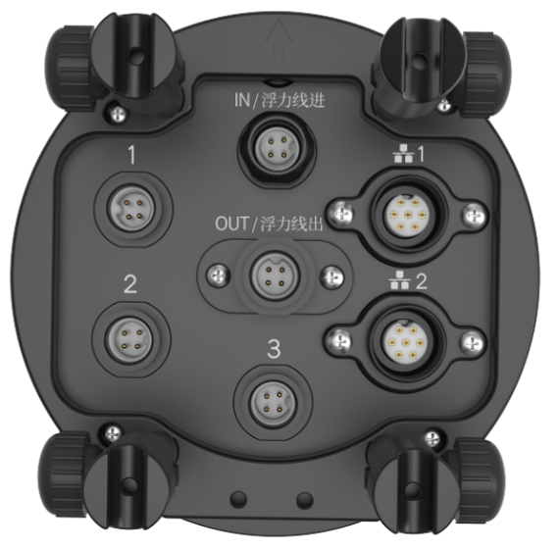
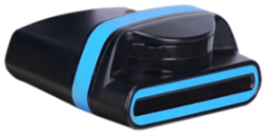
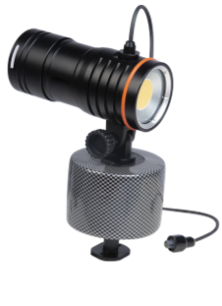
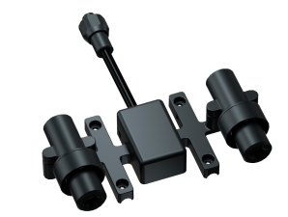
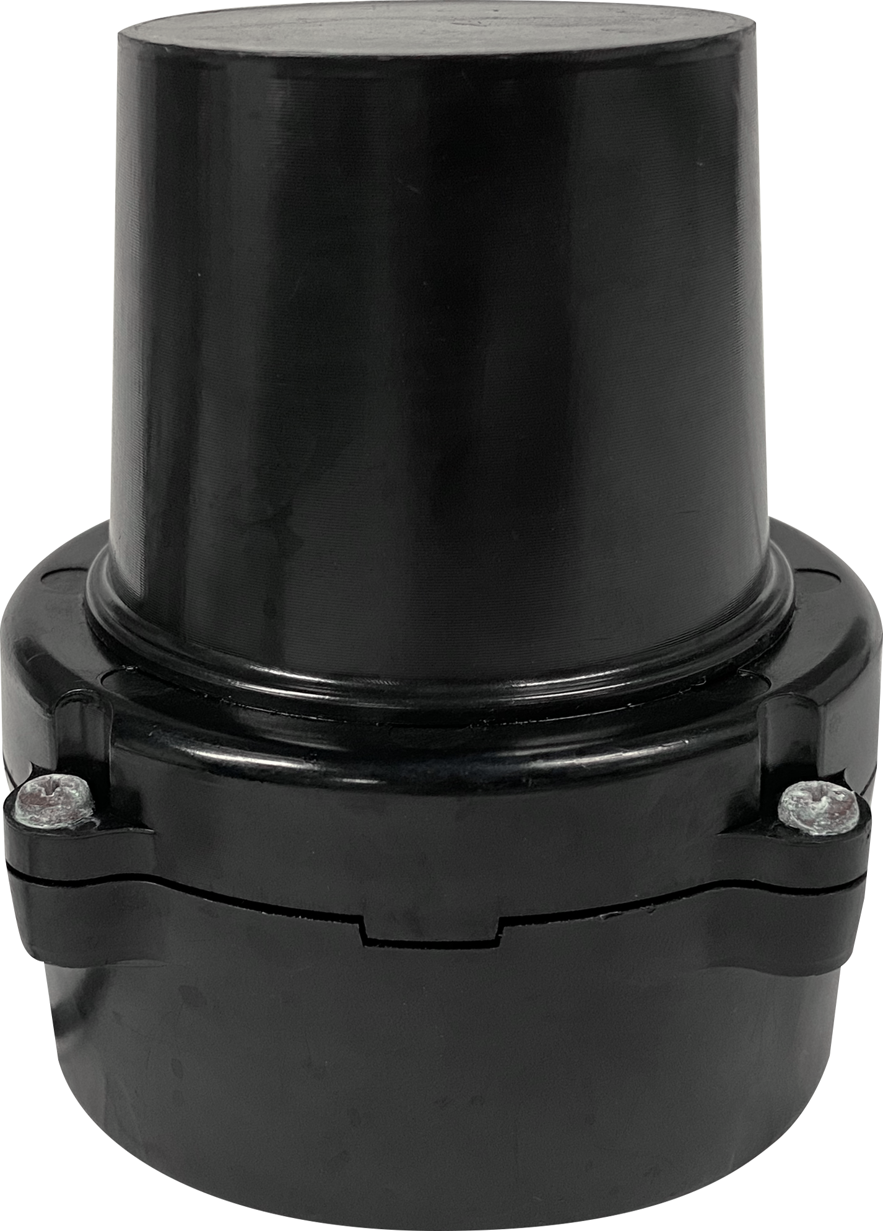
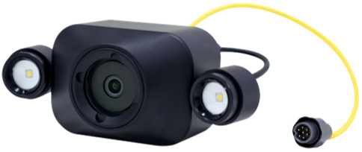
CHASING Multi-interface Docking Station is an accessory specially designed for use with CHASING M2 PRO ROV. It features a total of 5 expanding ports which can be used to expand advanced components such as the AC power supply system, auxiliary cameras, laser scalers, Multibeam Image Sonar, USBL positioning systems, and floodlights, enabling multiple accessories to be used at the same time. The modularized design is simple and portable, and installation is convenient and precise.
多波束成像声呐接口
辅助摄像头接口
LED灯
USBL
激光卡尺

Slide 3
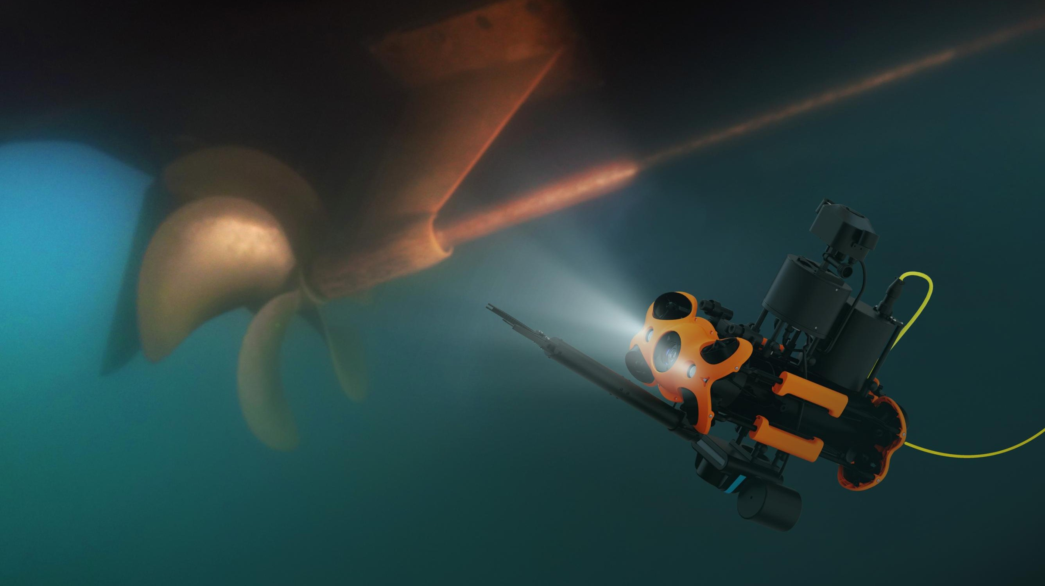
Use Multiple Components
at the Same Time
CHASING Multi-interface Docking Station can be used with advanced components like the AC power supply system, auxiliary cameras, laser scalers, Multibeam Image Sonar, USBL positioning systems, and floodlights, allowing it to adapt to the needs of a variety of tasks.

Slide 4
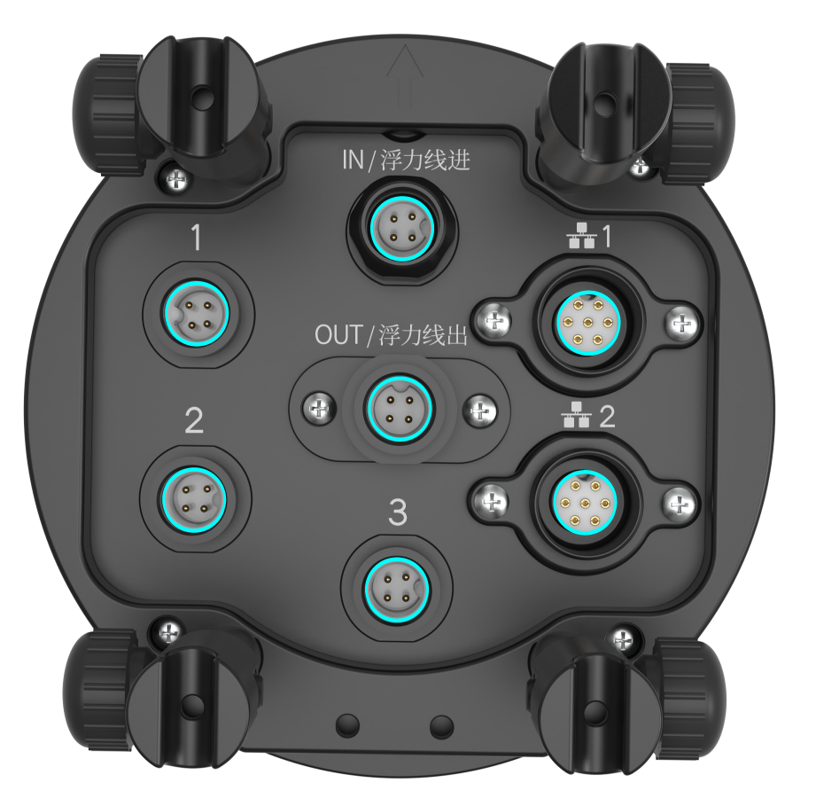
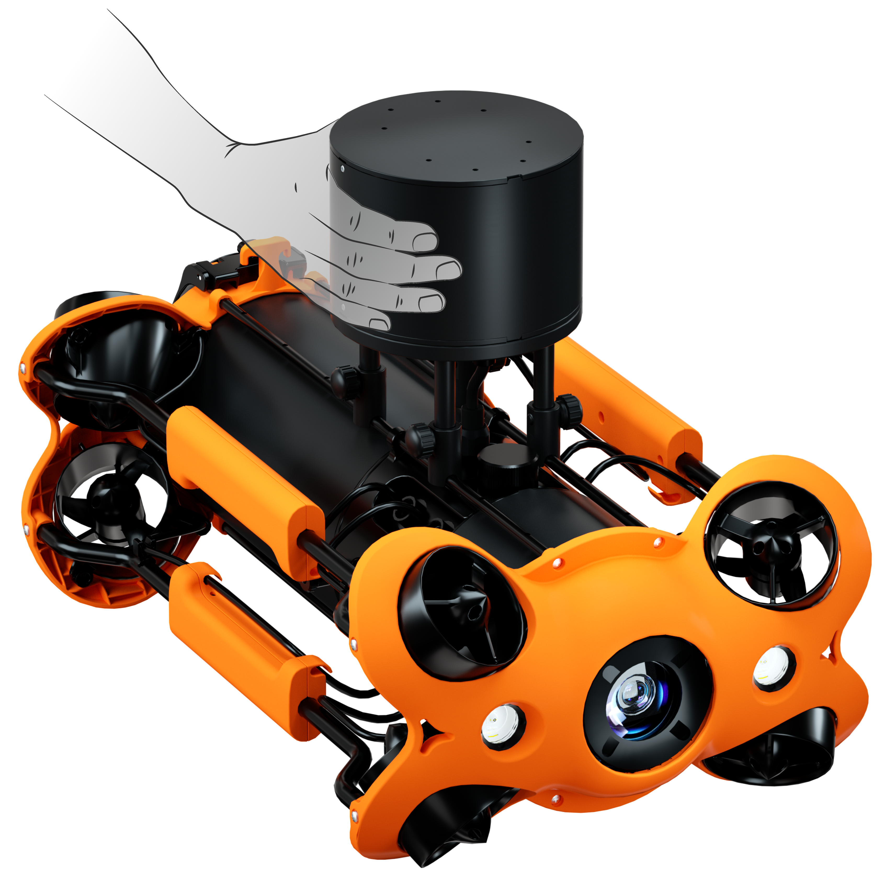
Simple, Portable, and Easy to Install
Features a simple and
portable modular design.
Has graphical instructions for each port, ensuring that installation is easy and precise.

Slide 5
Product Parameter
CHASING Multi-interface Docking Station
Size (mm) | 120*157 mm
Weight | ≈1050 g (air)
In-out | 16 V output
Port | UART*3, RJ45*2

Slide 6
CHASING Docking Station

