Slide 1
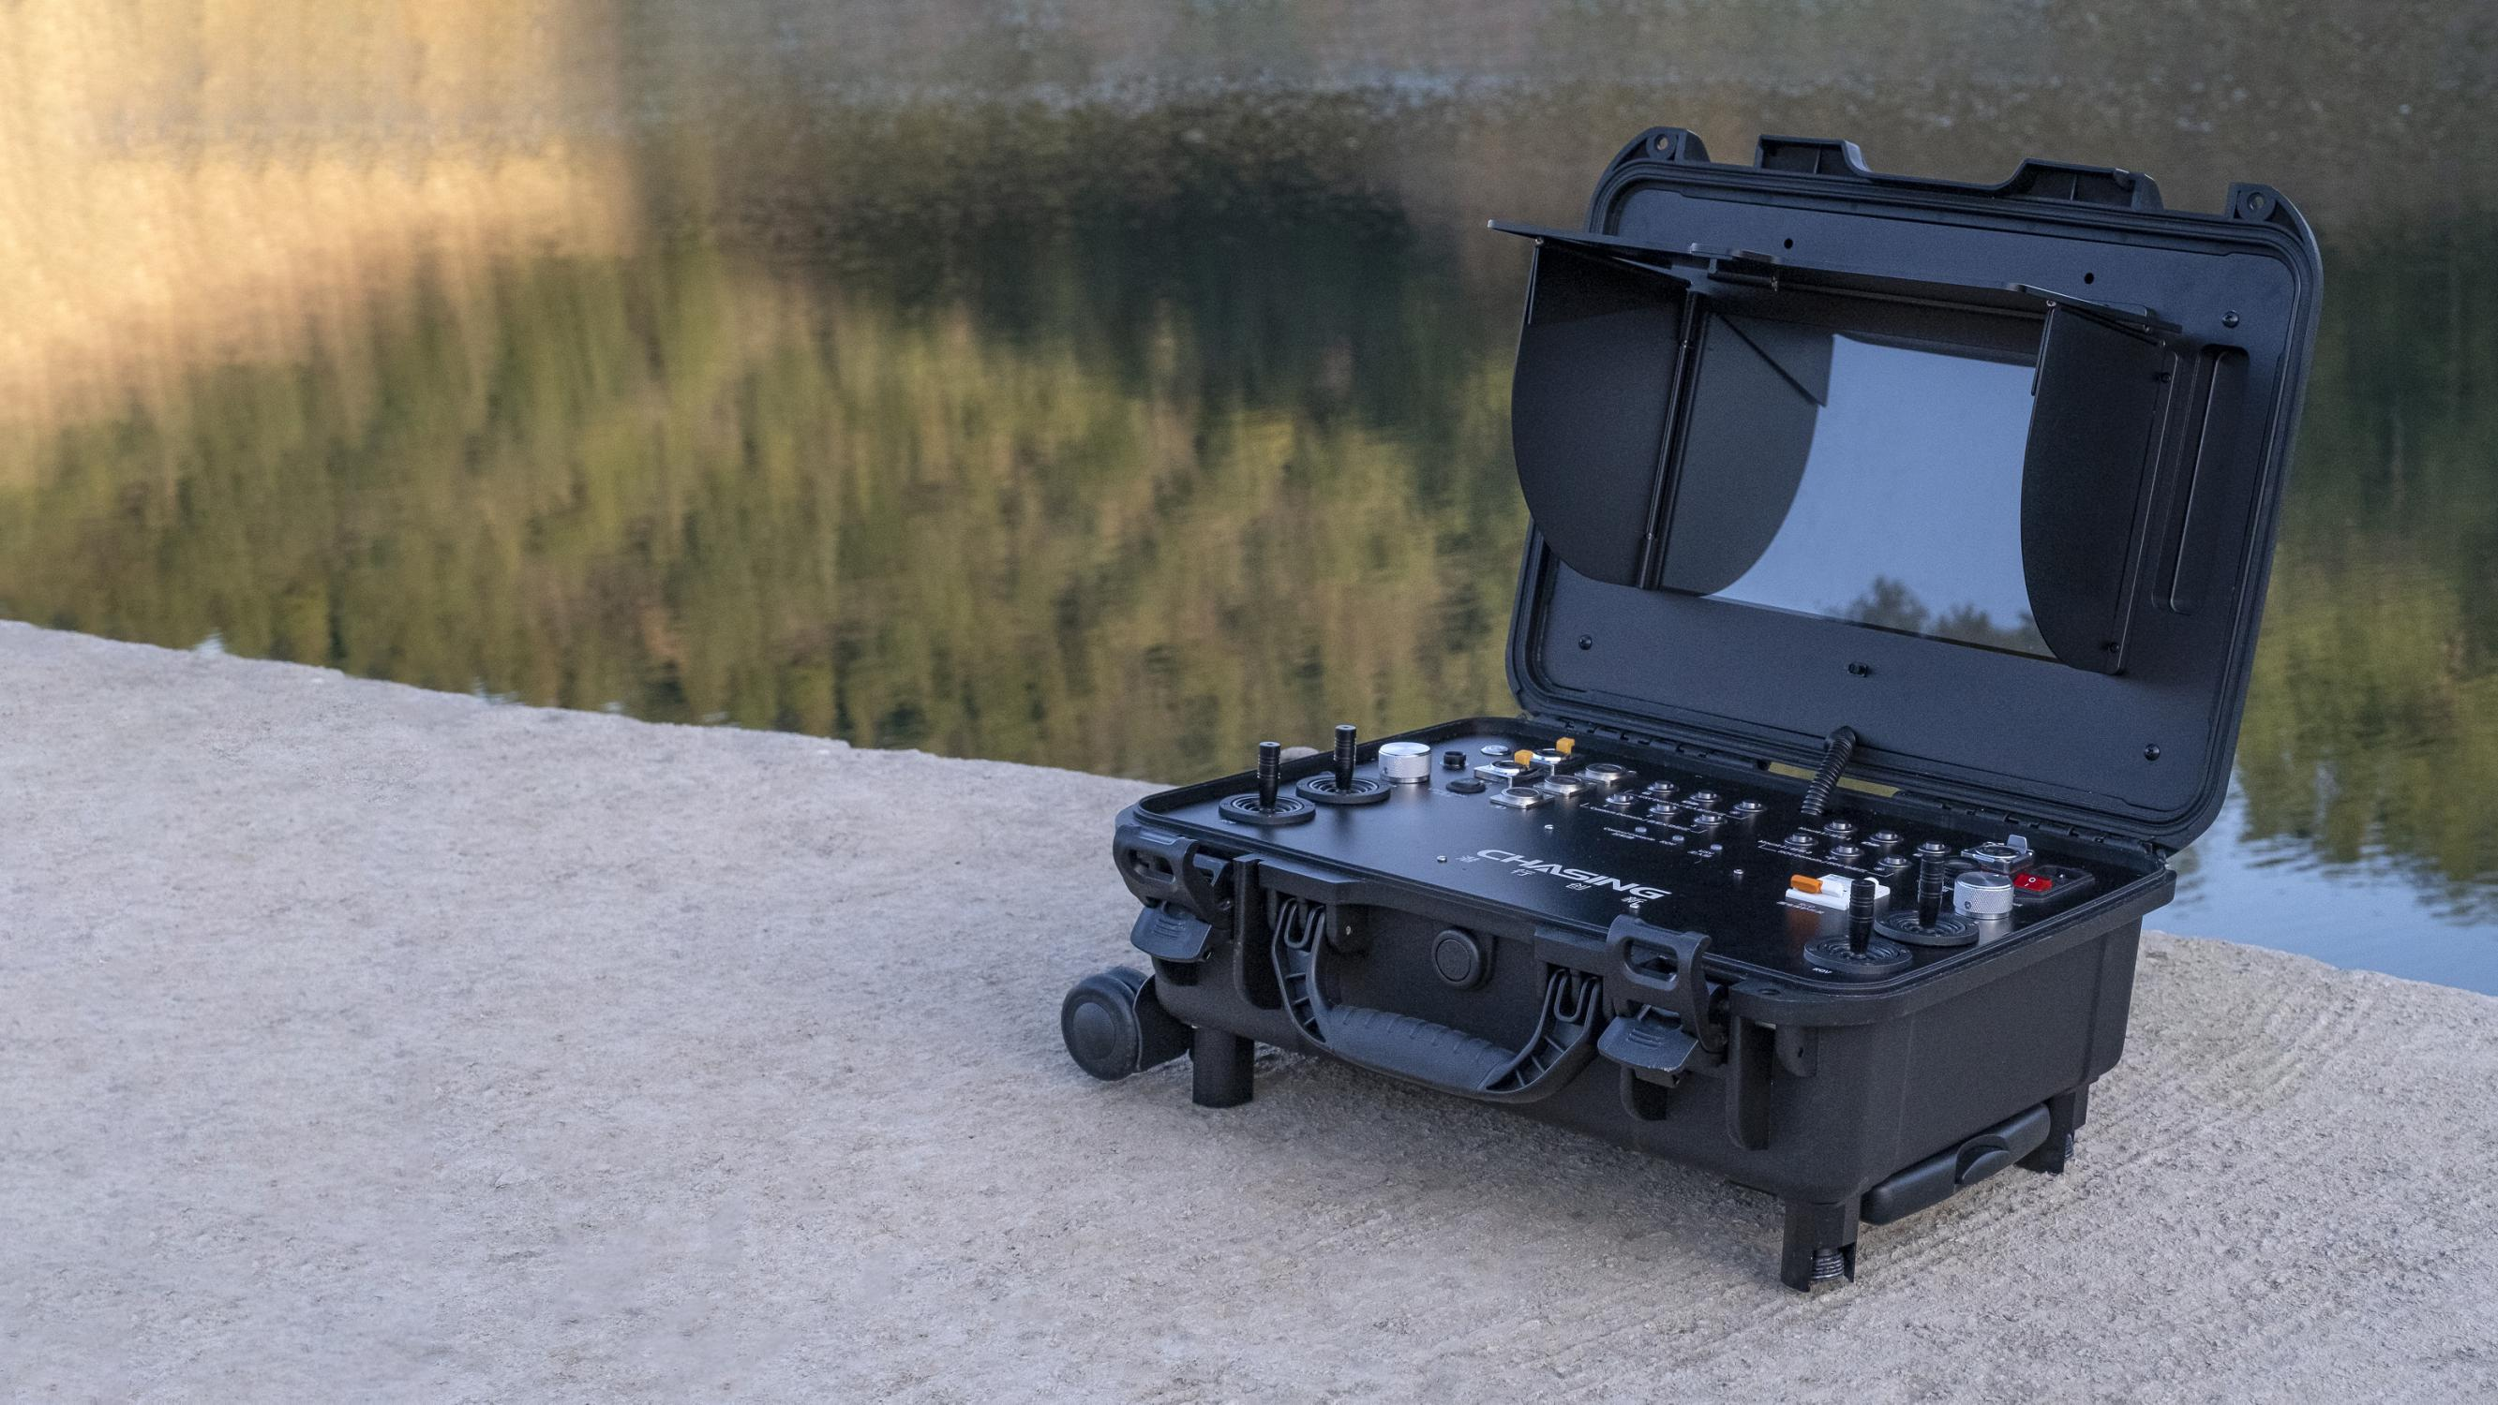
CHASING Control Console
Professional Control, Viewable in direct sunlight
Accessory specially designed for use with
CHASING M2 PRO ROV.

Slide 2
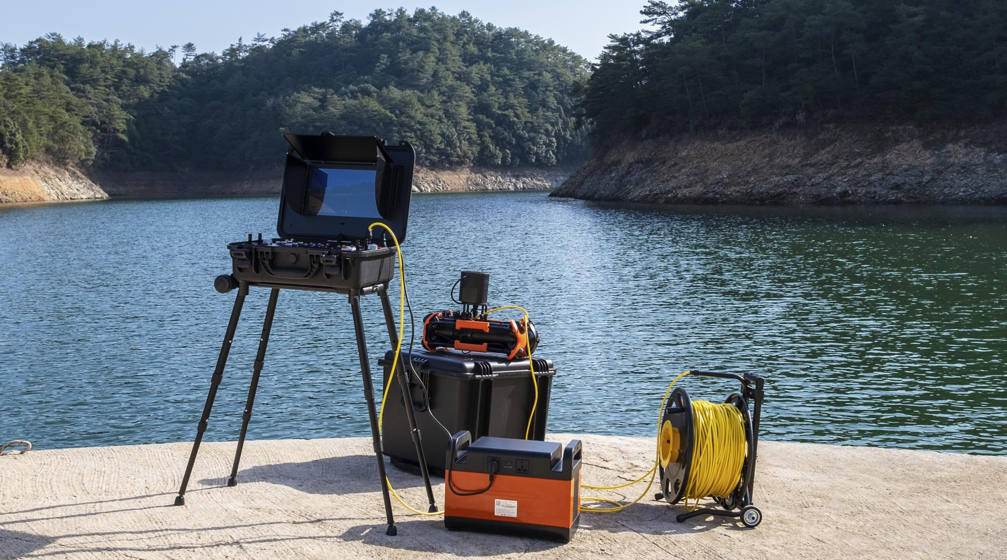
CHASING Control Console
is a professional control platform designed for high-end professional users. The Aluminum-alloy shell is strong and durable. The built-in 13.3-inch 1080P display delivers real-time ROV underwater images, which are clearly visible in even direct sunlight.The ergonomic control platform, with a number of well-designed switches, buttons and interfaces, makes it can control ROV and USV simultaneously, as well as AC direct power supply, USBL, manipulator arm, image sonar, external lights and other professional accessories. Four brackets can be set separately to adapt to various terrains.With rollers at the bottom, it can be easily carried like a suitcase after folding. It can work anywhere easily.

Slide 3
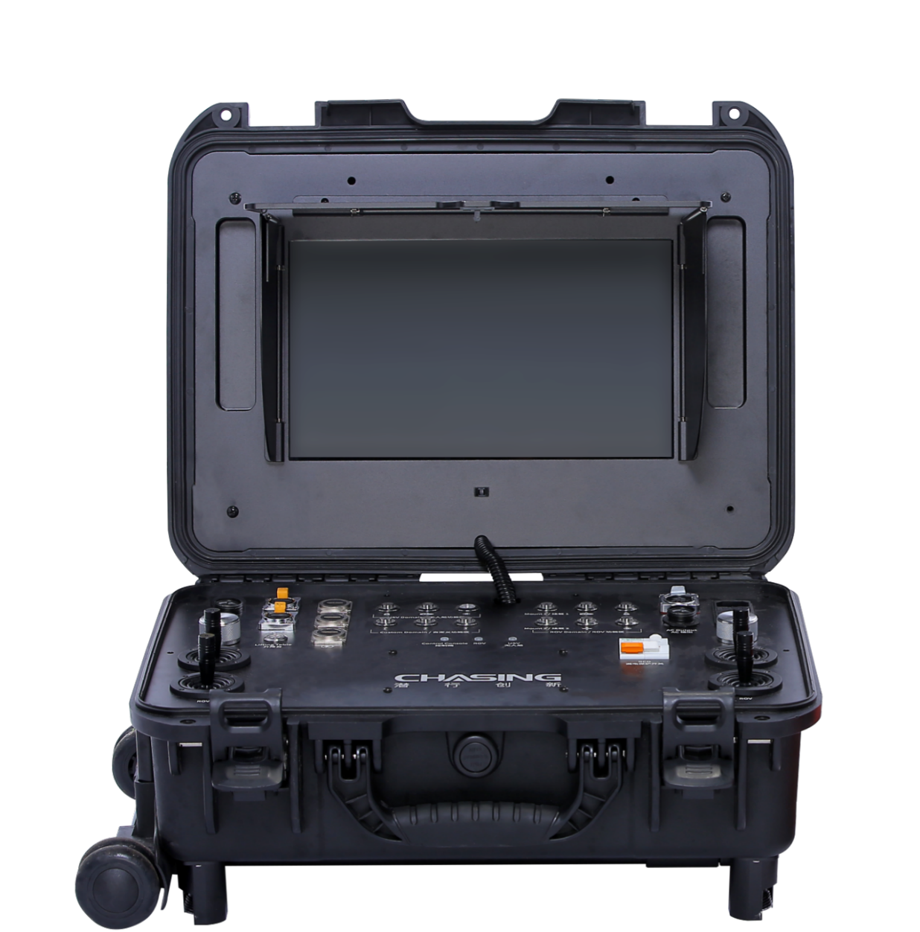
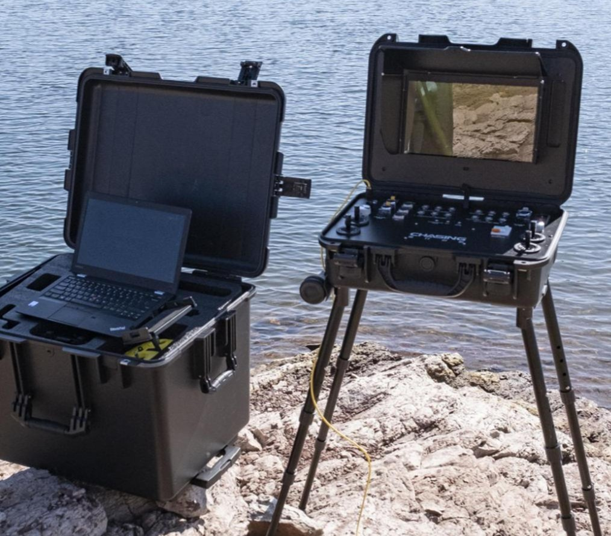
Built-in 13.3-inch 1080P Display
Viewable in direct sunlight

Slide 4
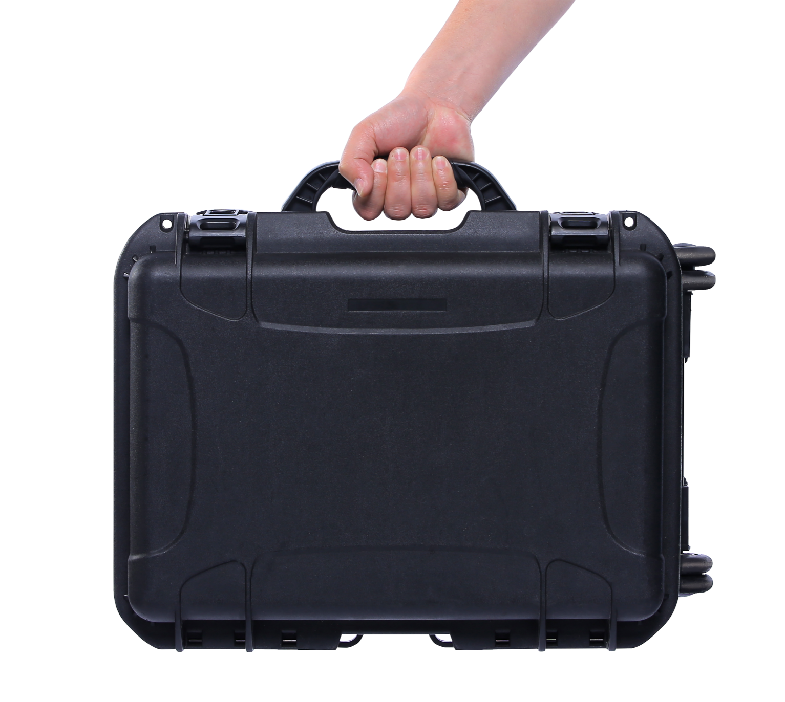
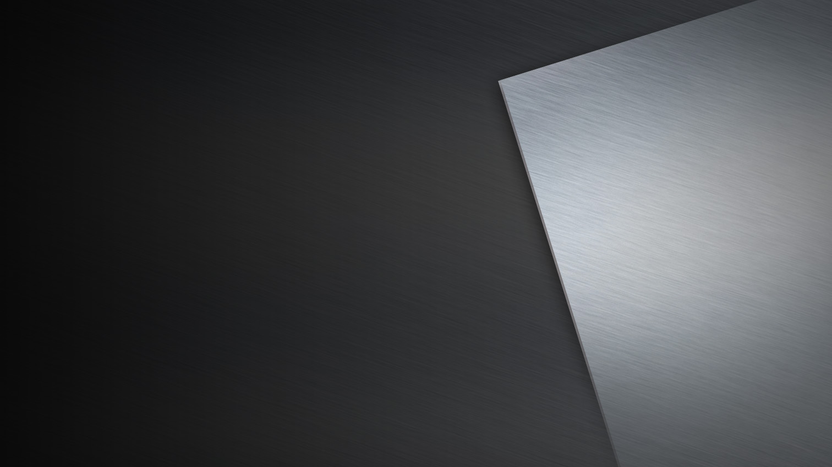
Aluminum-alloy Shell
Comfortable operating experience and precise control .

Slide 5
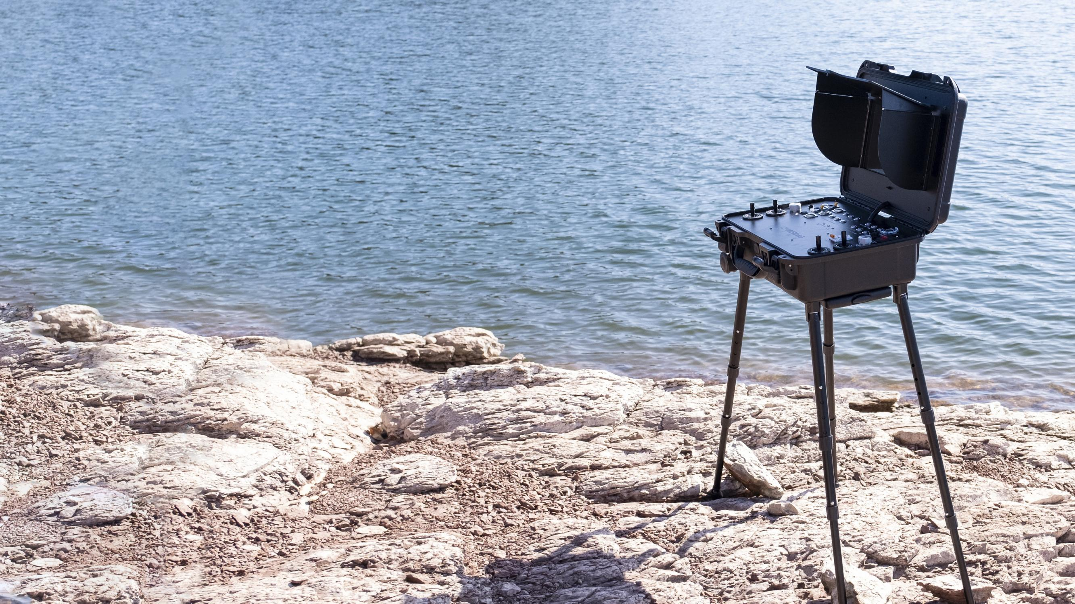
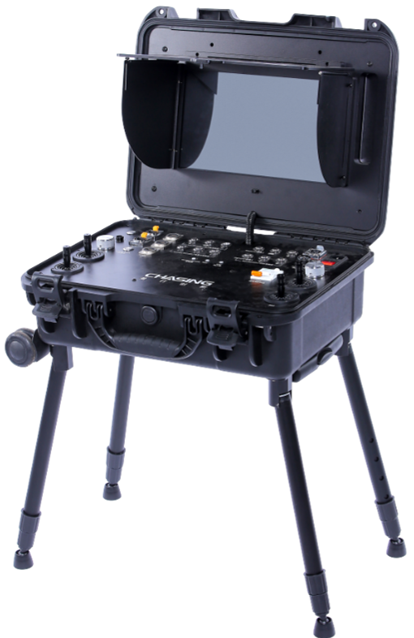
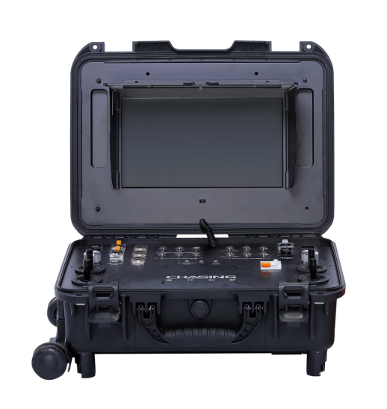
Variable Length Bracket
Quick assembly ,Suitable for all kinds of terrain.

Slide 6
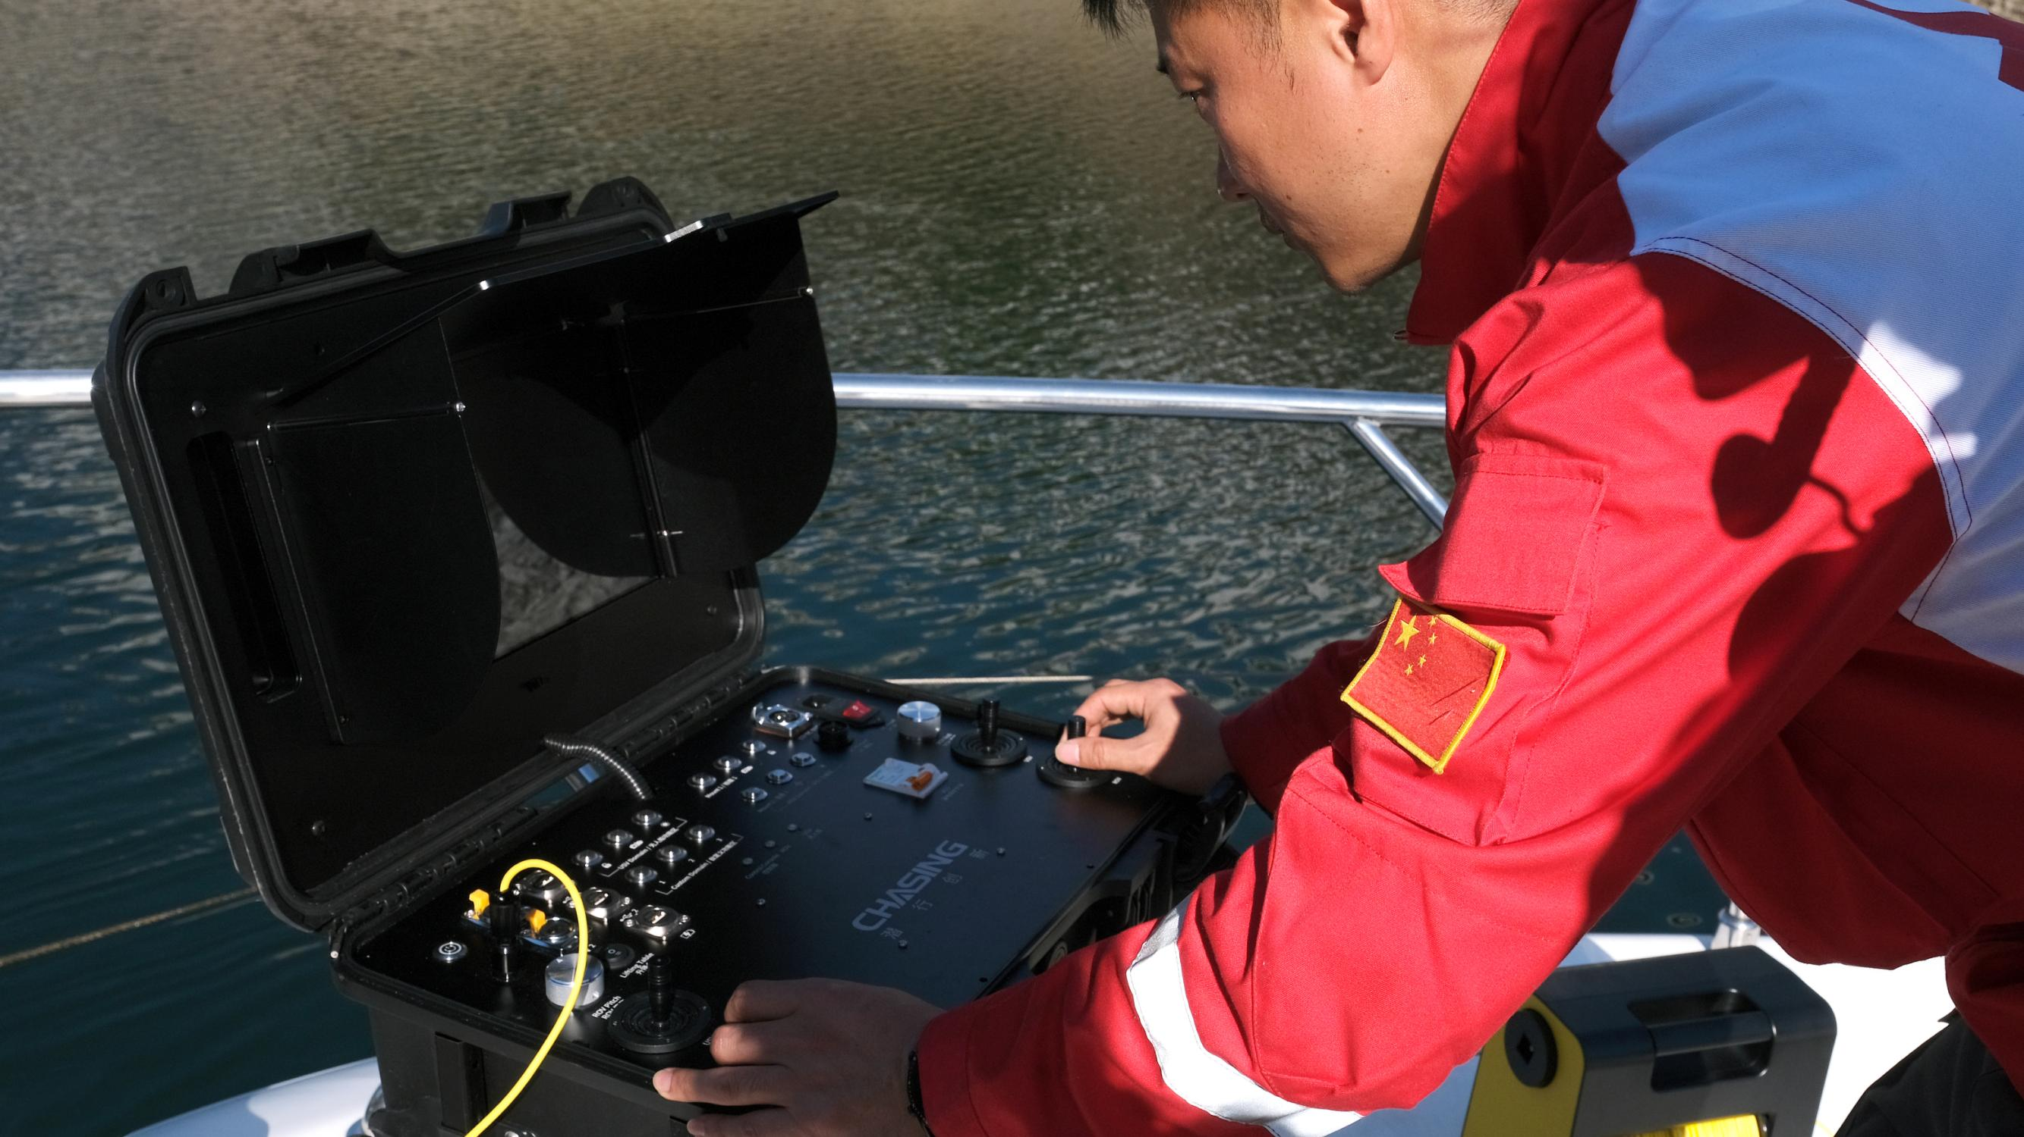
Ergonomic Control Platform
Comfortable operating experience and precise control.

Slide 7
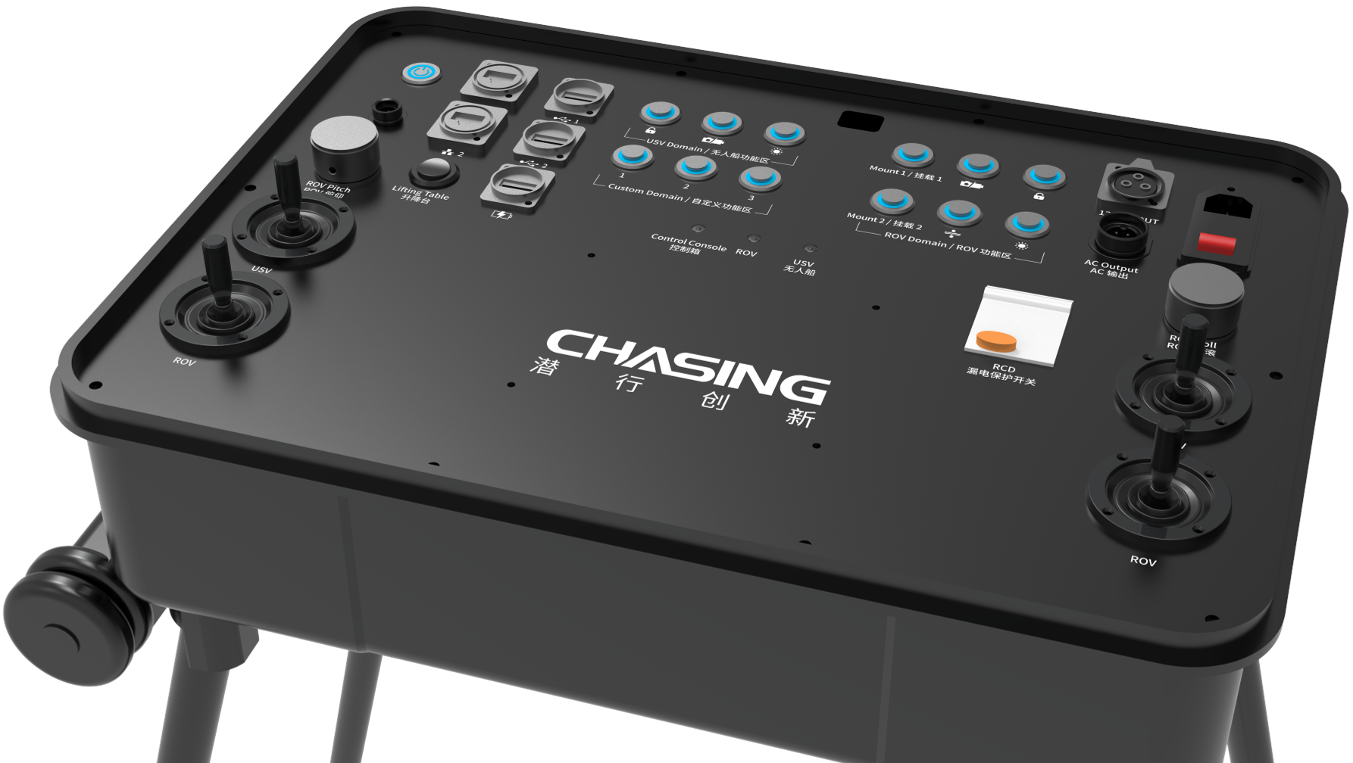
Multi-interface and Functions
ROV,USV,AC Power,USBL,Manipulator, Image SONAR, External Lights.

Slide 8
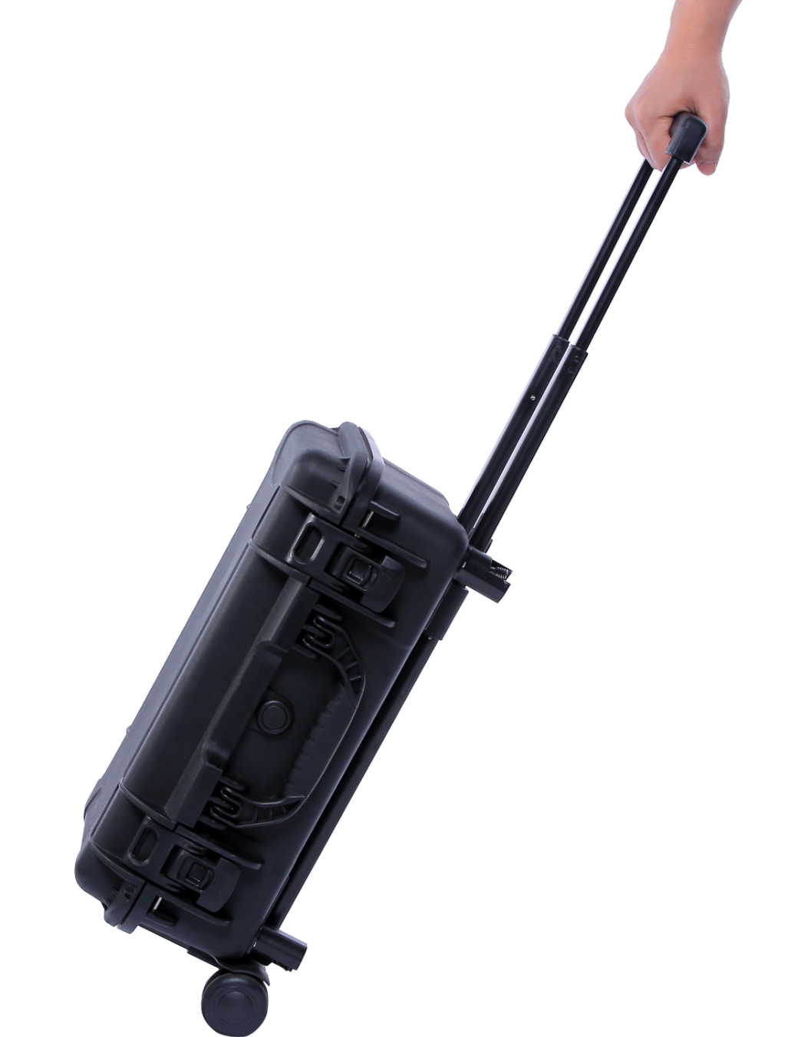
Luggage Case
Work anywhere easily.

Slide 9
Product Parameters
Control Console | SIZE | 484×375×178 mm
 | WEIGHT | 11KG
 | OPERATING TEMP | -10℃~45℃
Screen | SIZE | 13.3 Inch
 | RESOLUTION | 1920×1080
 | DISPLAY BRIGHTNESS | 1000 cd/㎡
Interface | INTERFACE | RJ45 × 2 USB 2.0 Host × 2 QC 3.0 USB ×1
 | AC INPUT | 200 V ~ 240 V
 | AC OUTPUT | 220V
Battery | RUNTIME | 8 Hours
 | BATTERY | 226.8WH
 | CHARGE TIME | 3A Charger: 4.5 Hours

