Slide 1
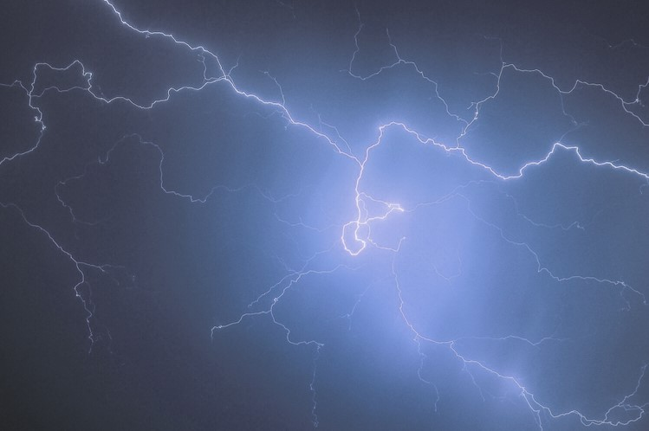
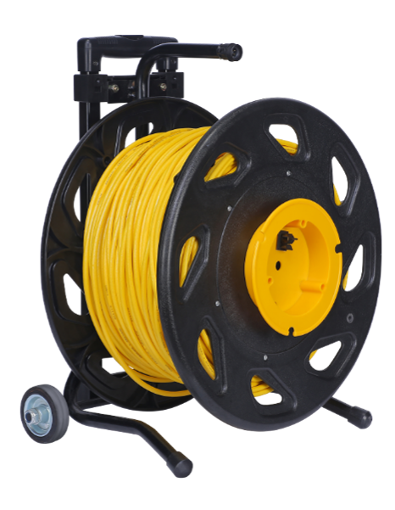
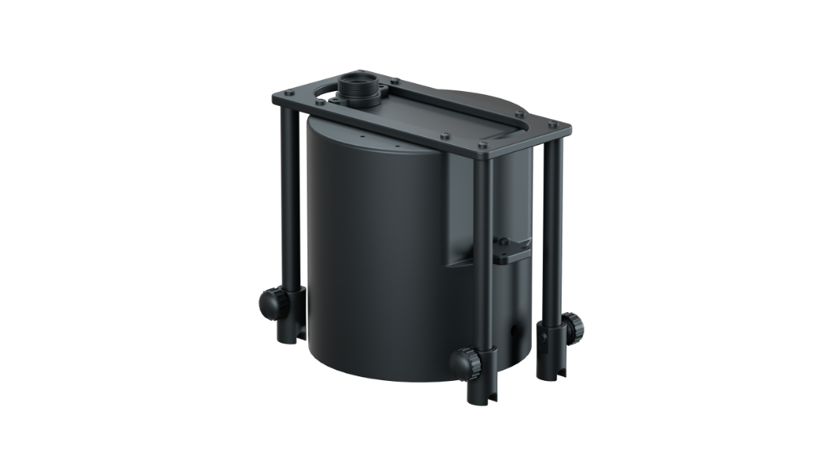
CHASING AC POWER SUPPLY
Accessory specially designed for use with
CHASING M2 and CHASING M2 PRO ROV.
www.chasing.com

Slide 2
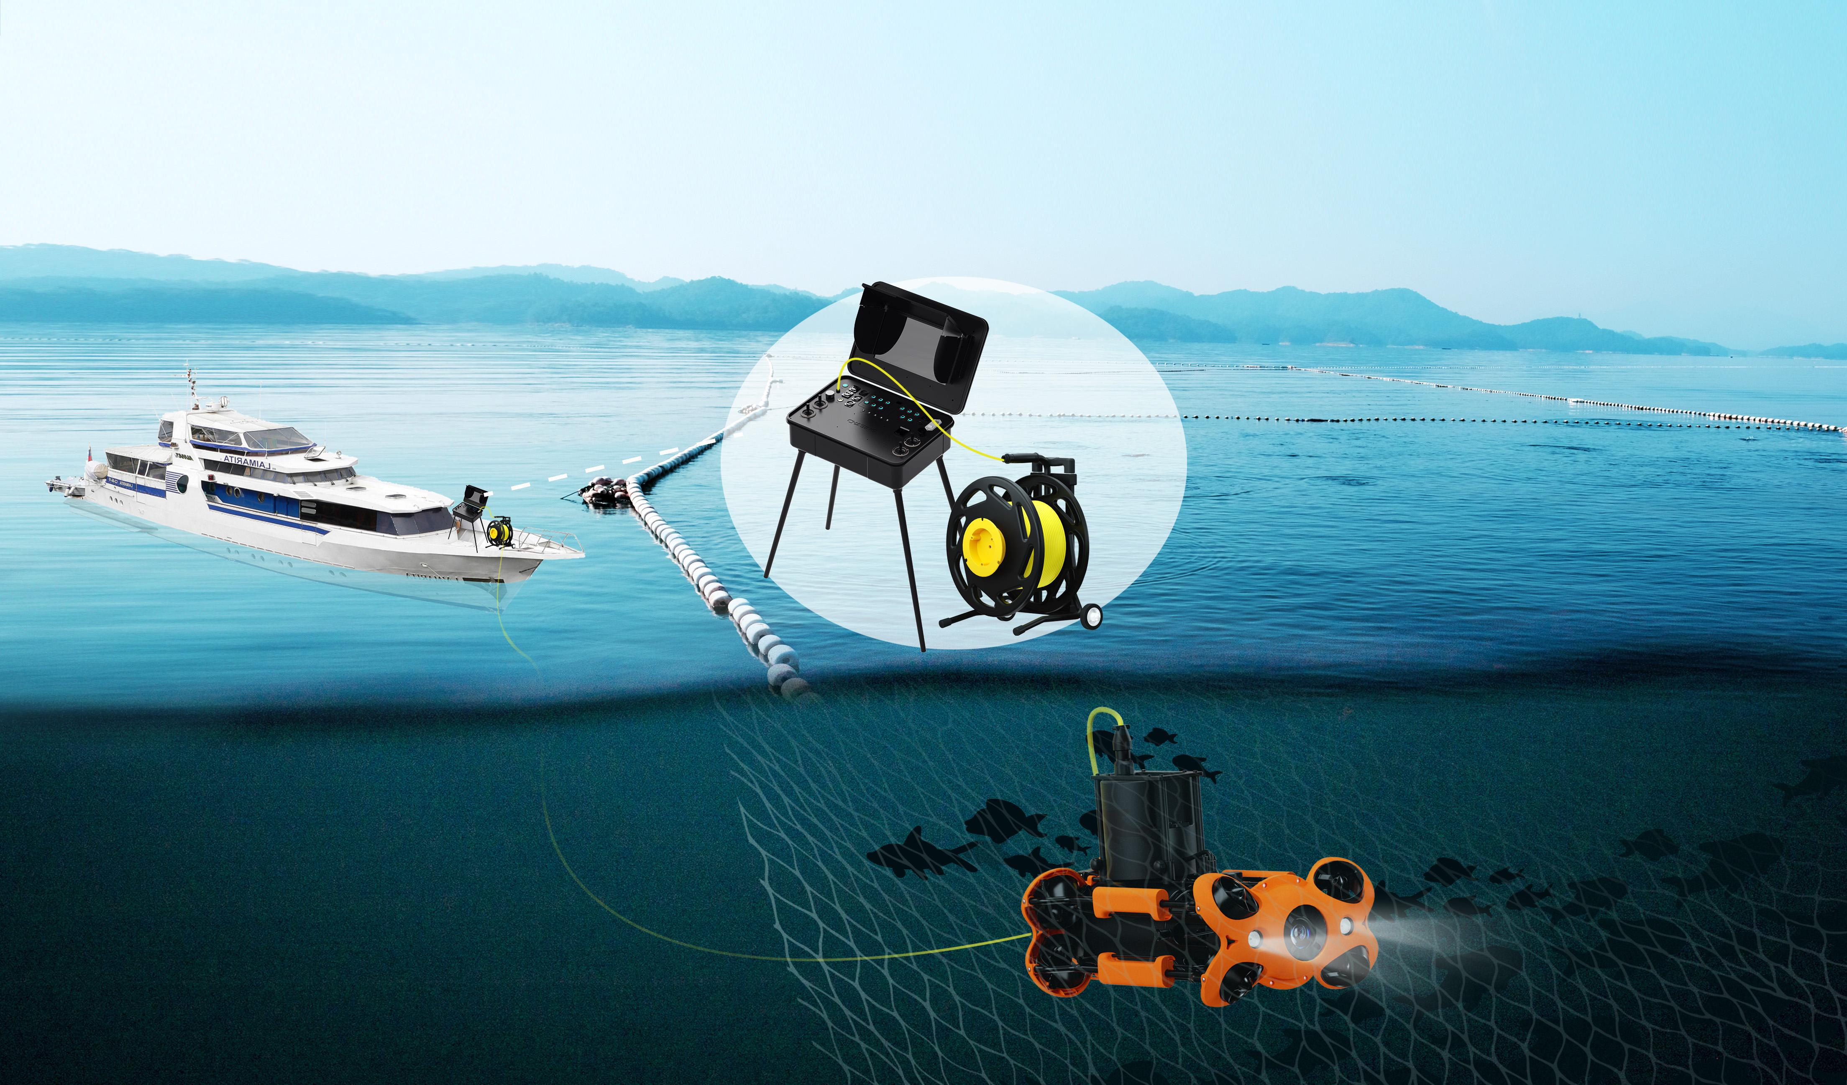
CHASING AC POWER SUPPLY is specially designed for use with the Gladius series ROVs of CHASING M2 and CHASING M2 PRO . Paired with the CHASING high-brightness screen control console or CHASING adapter box, the ROV supports various power supply via AC current or battery, allowing extended operating time. CHASING AC Direct Power Supply System outputs power at 250W. Its reel is equipped with a pull rod and scroll wheel that are easy to use and convenient to assemble and disassemble. 100 and 200 meter cables provide long-distance power supply.

Slide 3
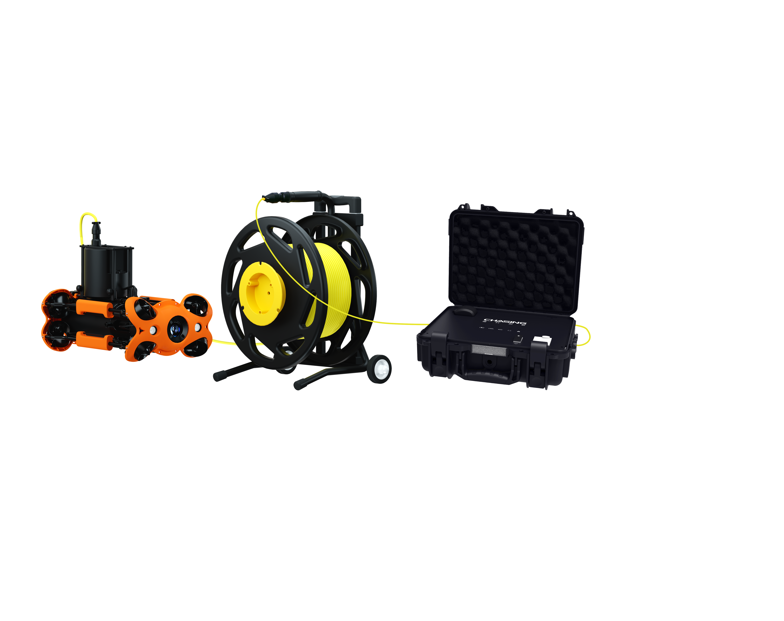
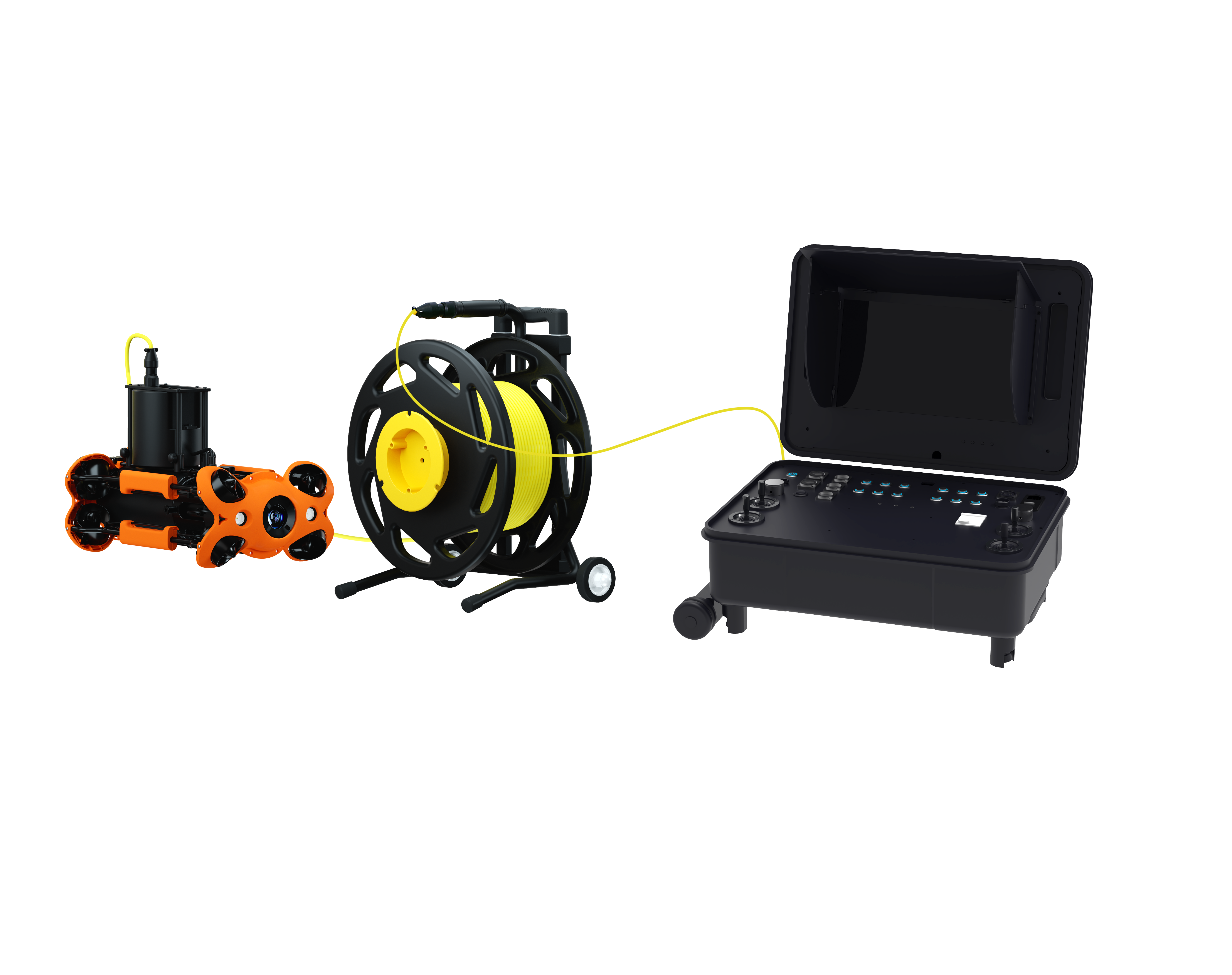
Continuous power supply, long-lasting operation
CHASING AC Direct Power Supply System can be used with the CHASING high-brightness screen control console or CHASING adapter box to power and recharge the ROV during use, allowing the ROV to operate continuously.
—— Scheme with CHASING Adapter Box
—— Scheme with CHASING Control Console

Slide 4
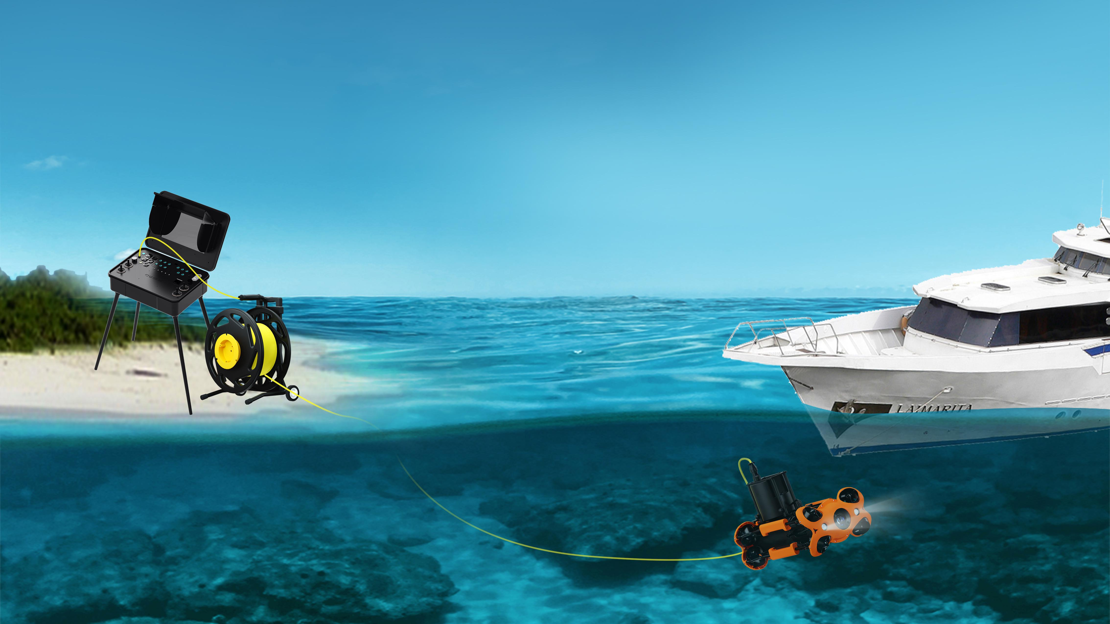
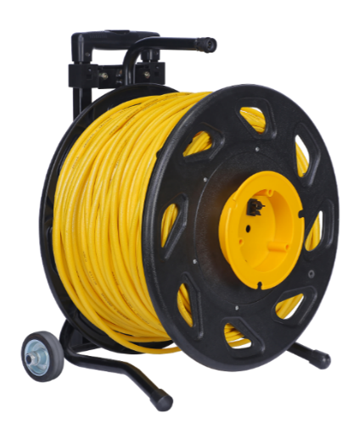
Long-distance power supply
Use the CHASING AC system with a 100 or 200 meter cable to supply power to the ROV across long distances.
100m tether 200m tether

Slide 5
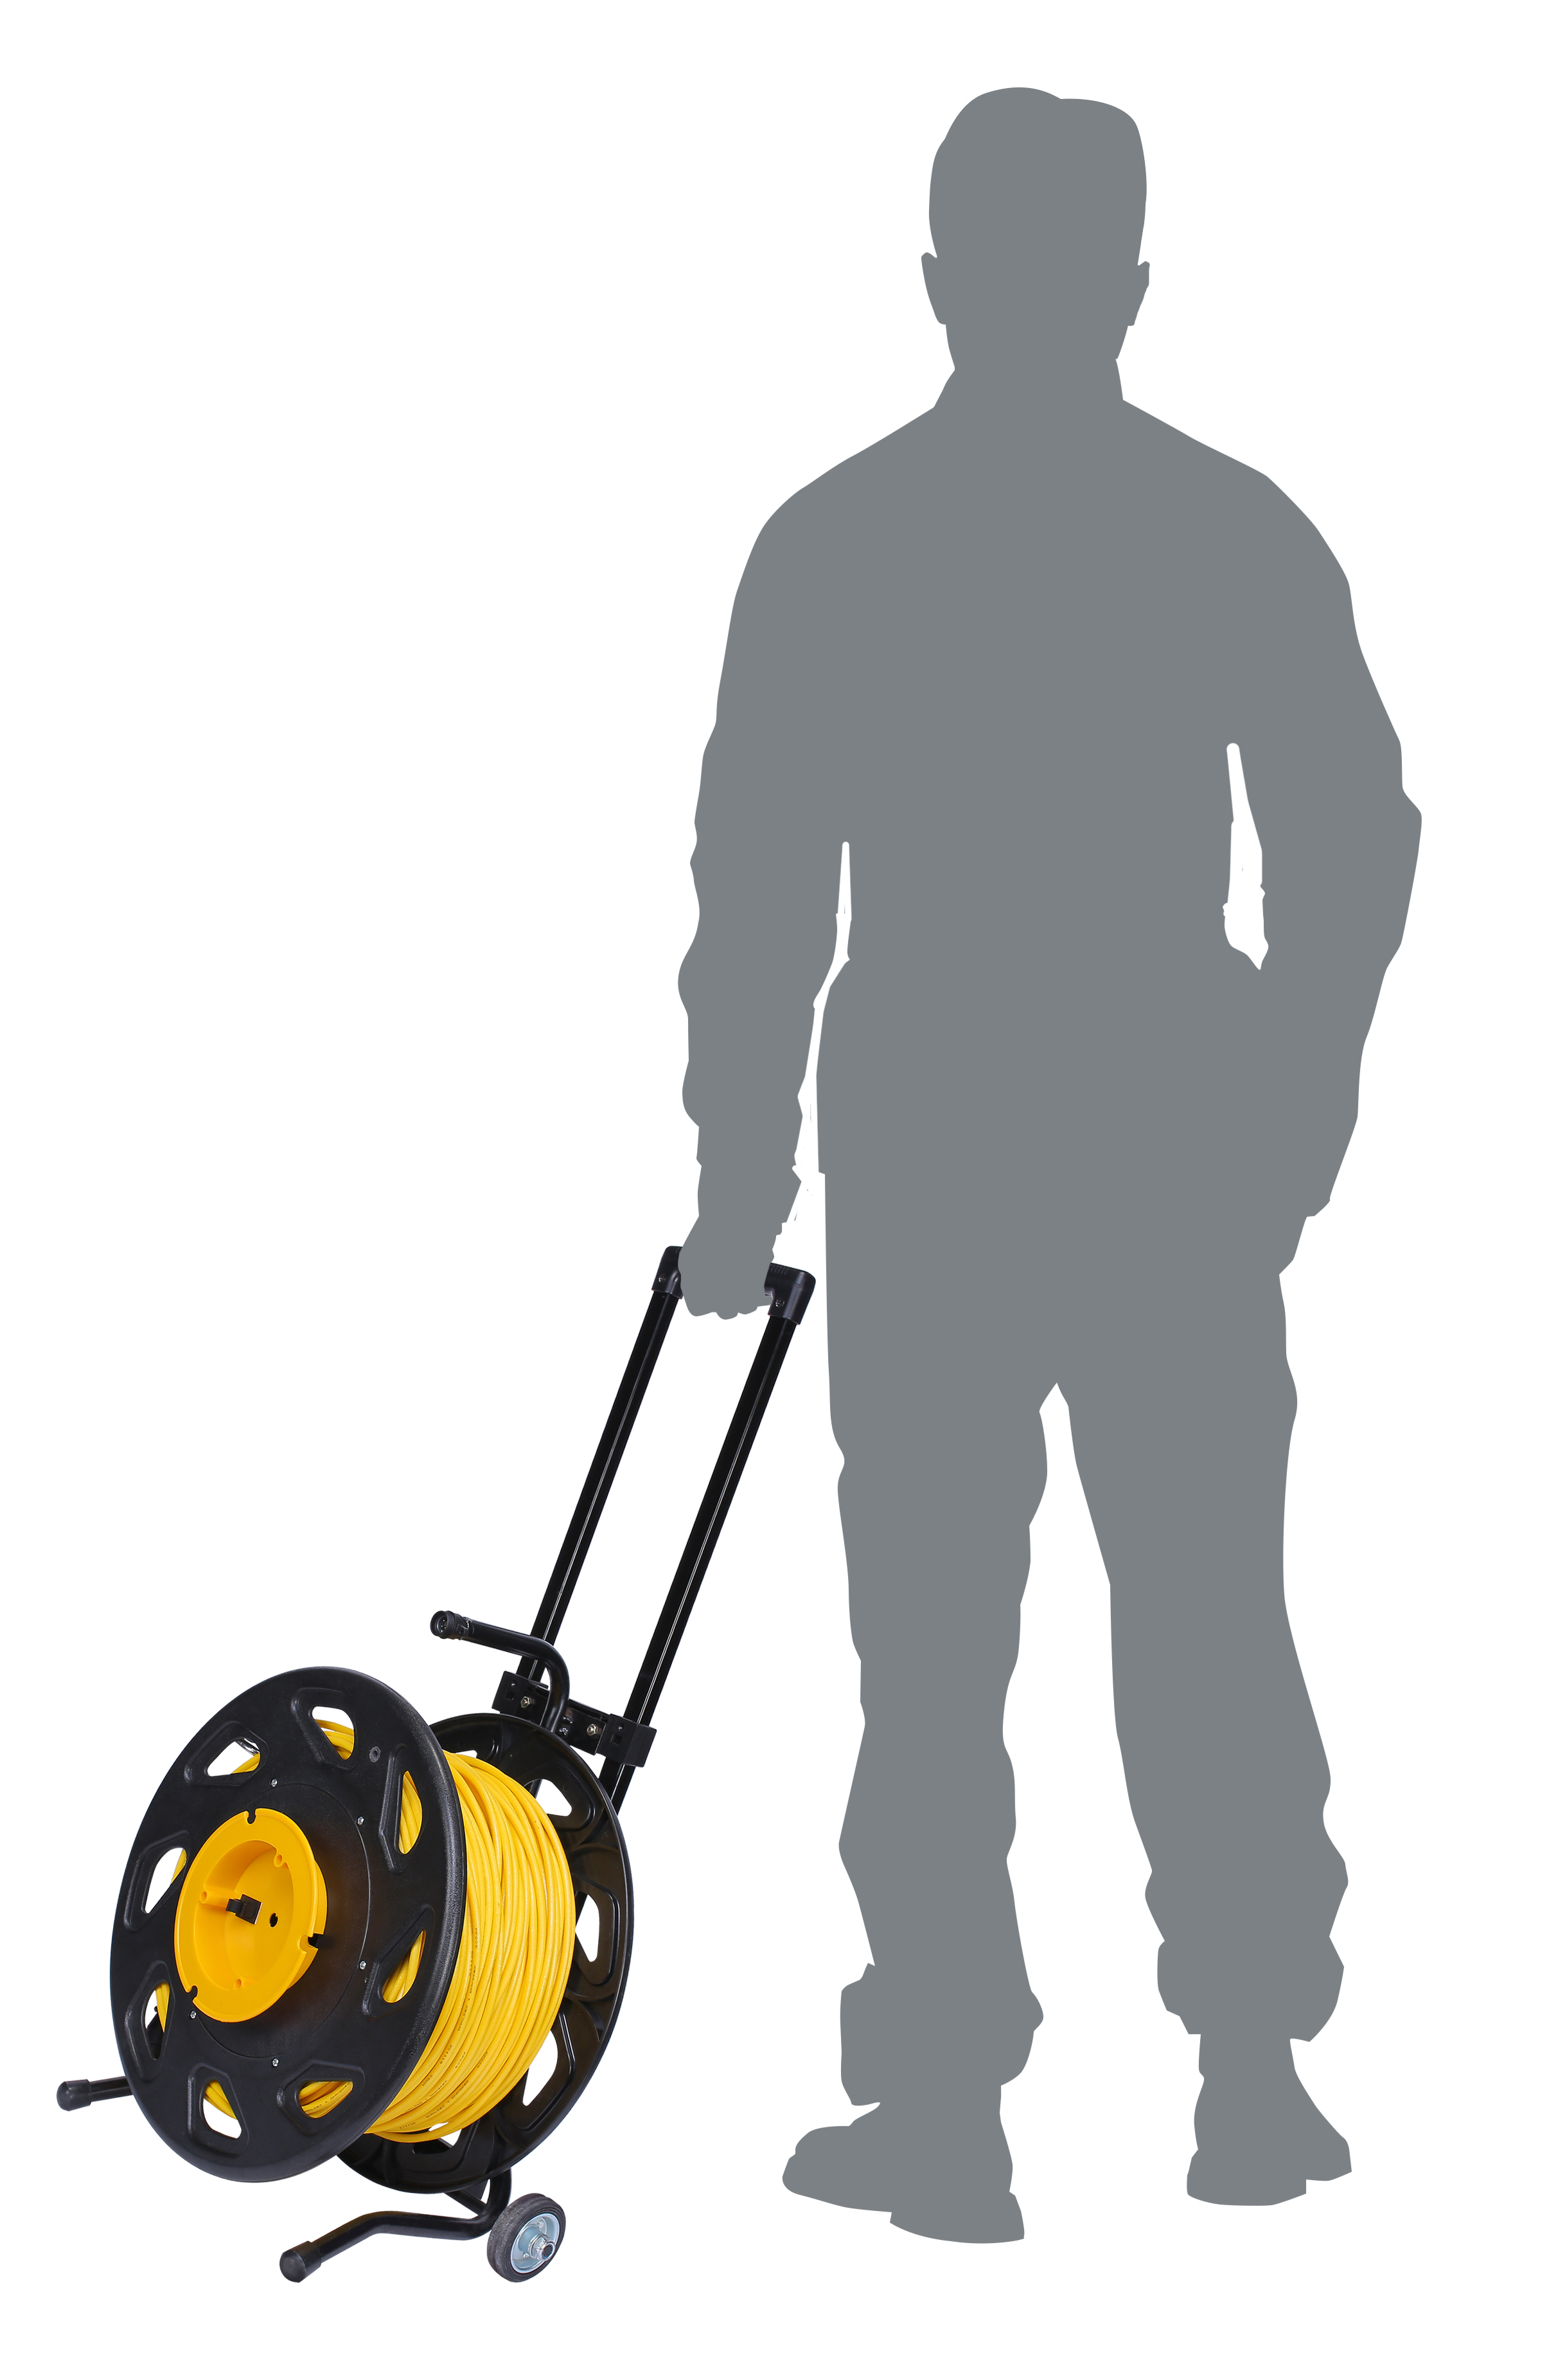
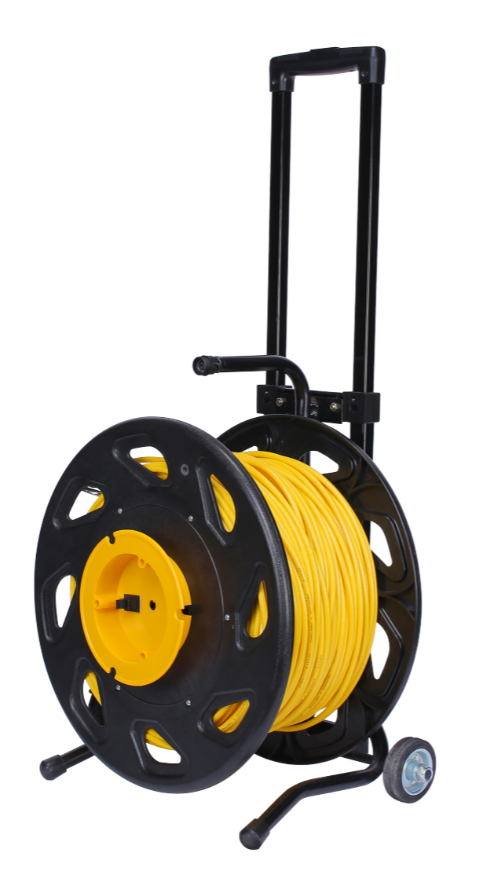
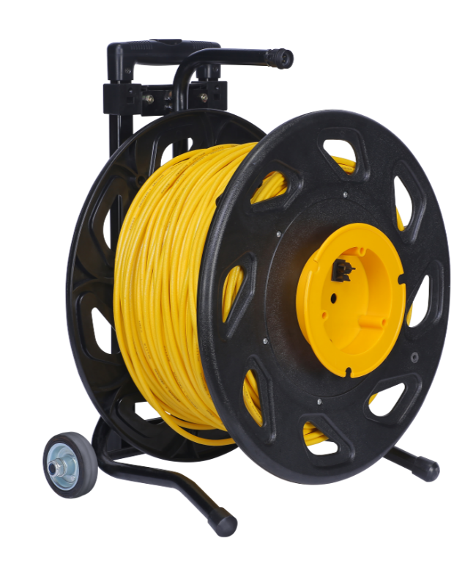
Highly portable and easy to transport
CHASING AC Direct Power Supply System comes equipped with a winder with a pull rod and scroll wheel that are highly portable and easy to transport.

Slide 6
Product Parameter
CHASING AC Direct Power Supply System
ACpowersupply | Size(mm) | 118*148.5mm
 | Weight | 1200g
 | In-out | InputAC200-240V,OutputDC25.2V10A
 | Power | 250W
AC direct power supply cable | Length | 100/200 meters
 | Wirediameter | 6.5mm
 | Corewire | Silver-coatedcopper27AWG*2+25AWG*2

Slide 7
CHASING AC POWER SUPPLY

